Slide 1
Image Classification: From Classic ML to Deep Learning
Computer Vision

Slide 2
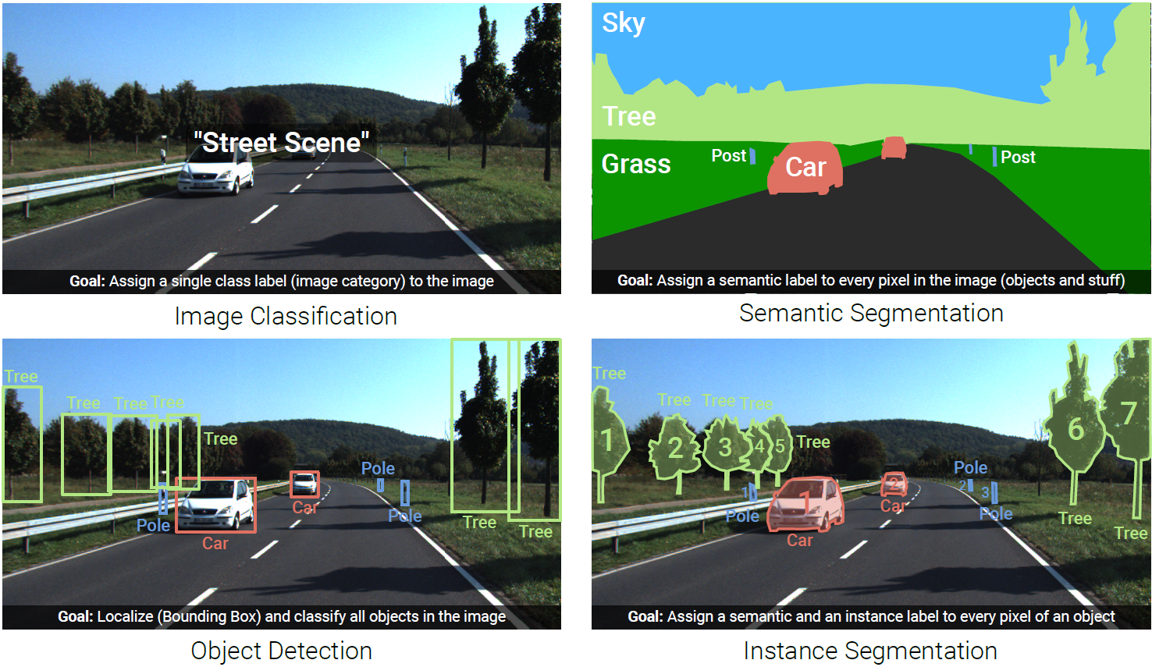
Image Understanding (Recognition)

Slide 3
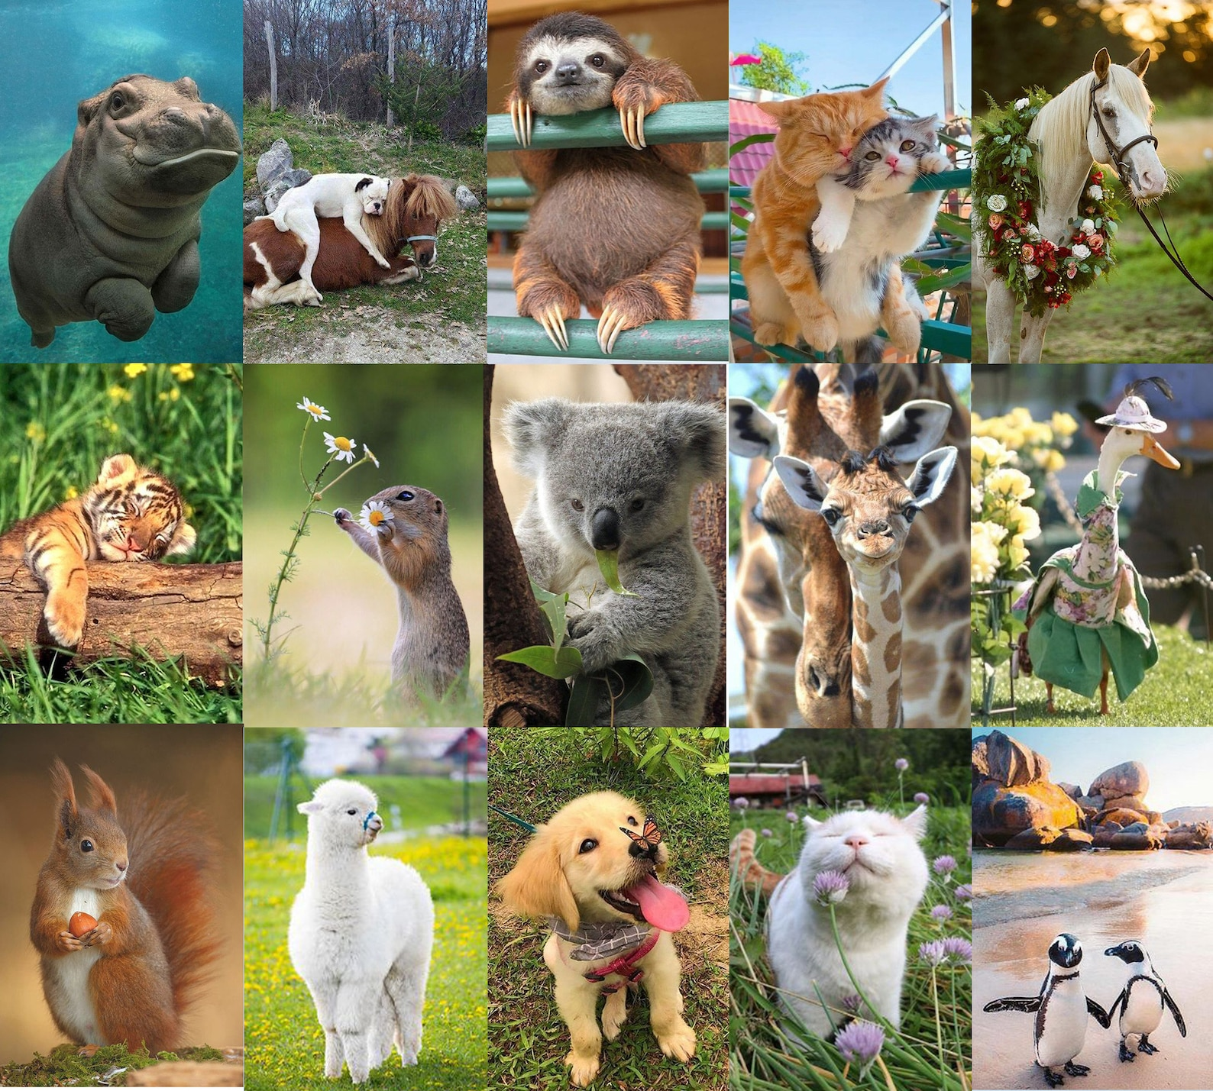
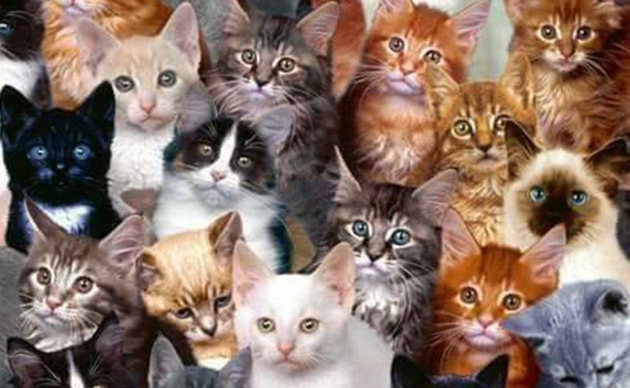
Need for ML
prime example (and also foundation for detection and segmentation):
image classification (whole-image class recognition) according to generic object categories (e.g., cat)
plain keypoint-feature matching only really works for specific instances of a class
→ need to compare with generic objects (e.g., kind of “abstract cat”)
Let’s learn it from data …
What if you haven’t seen this very cat before?

Slide 4
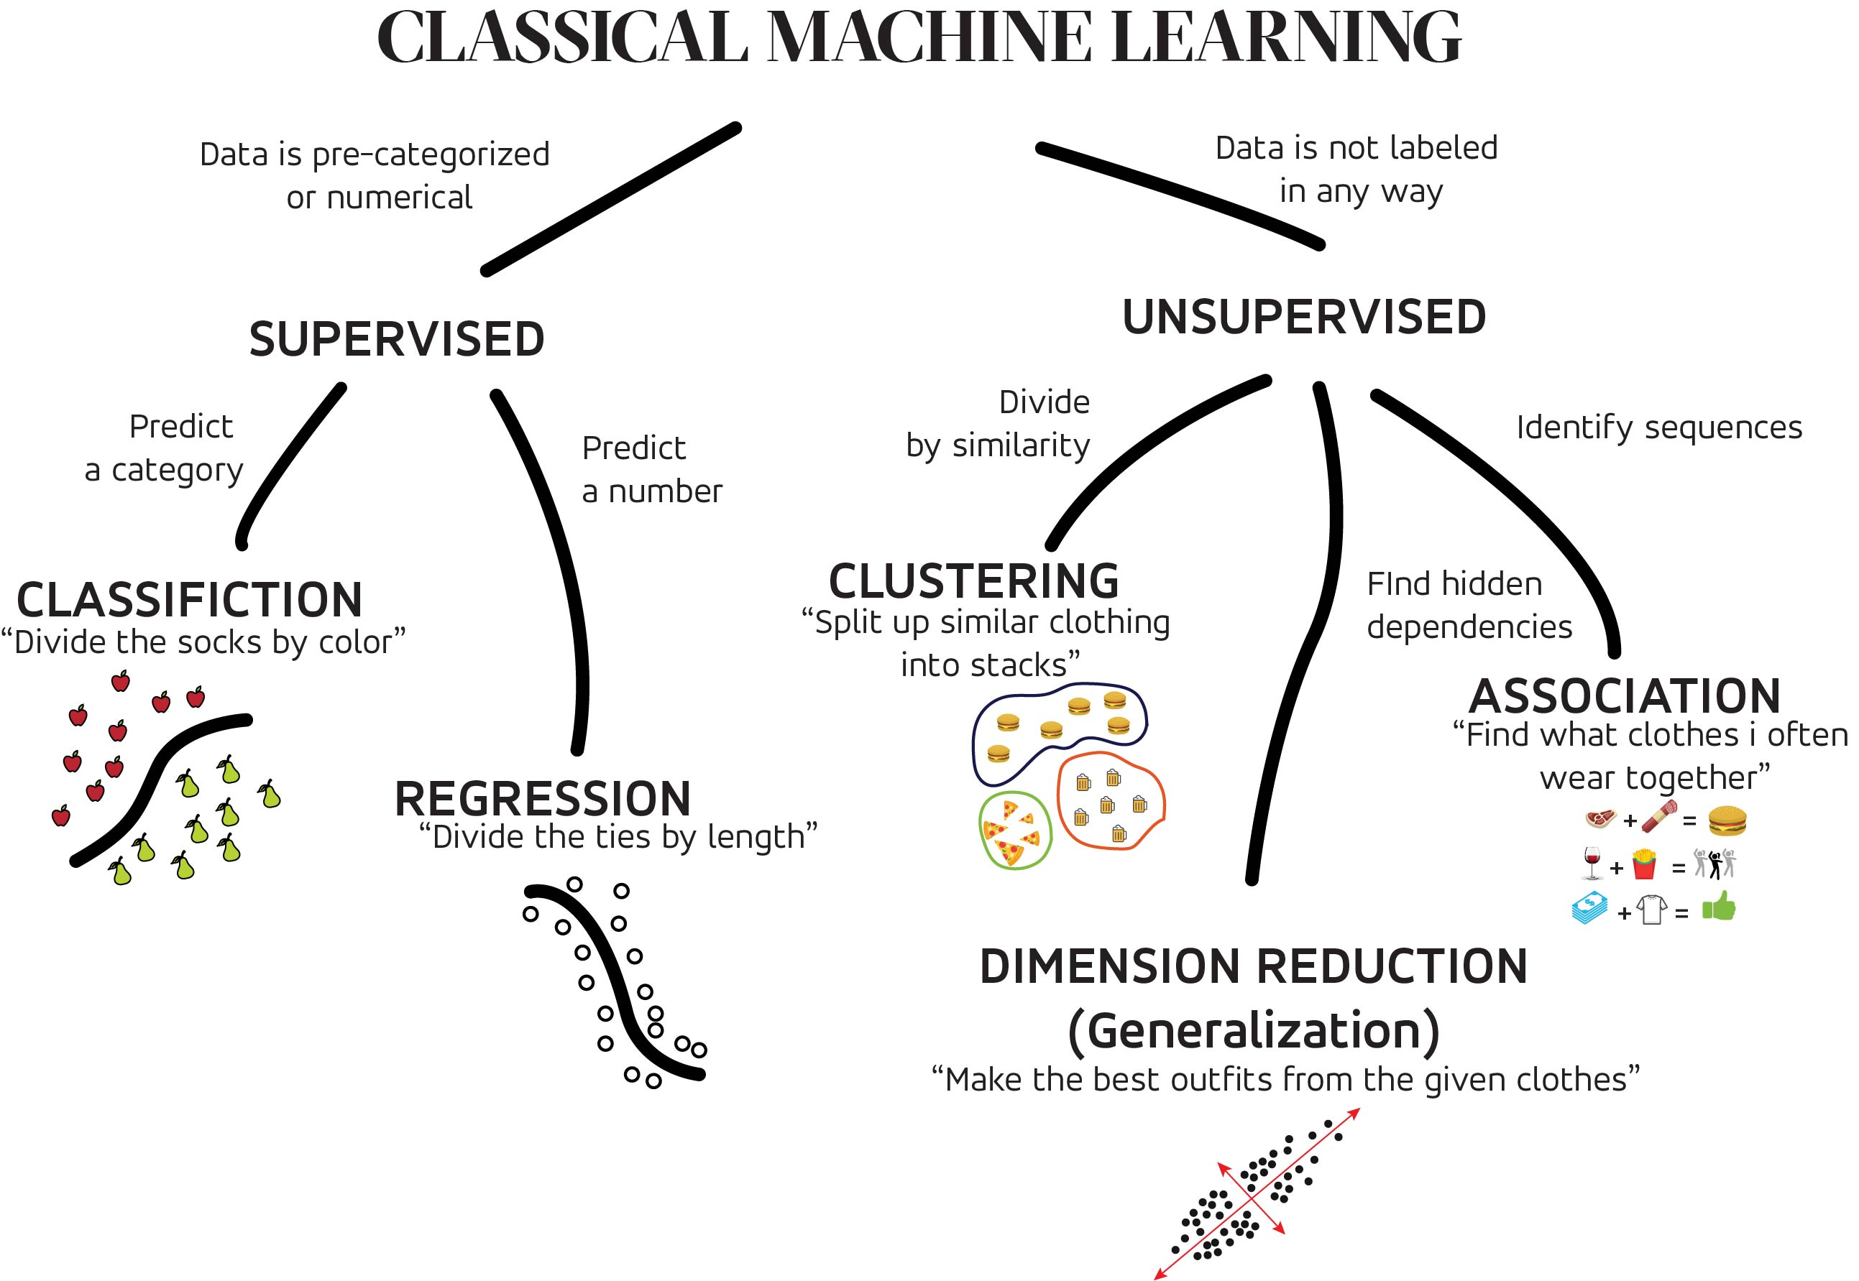
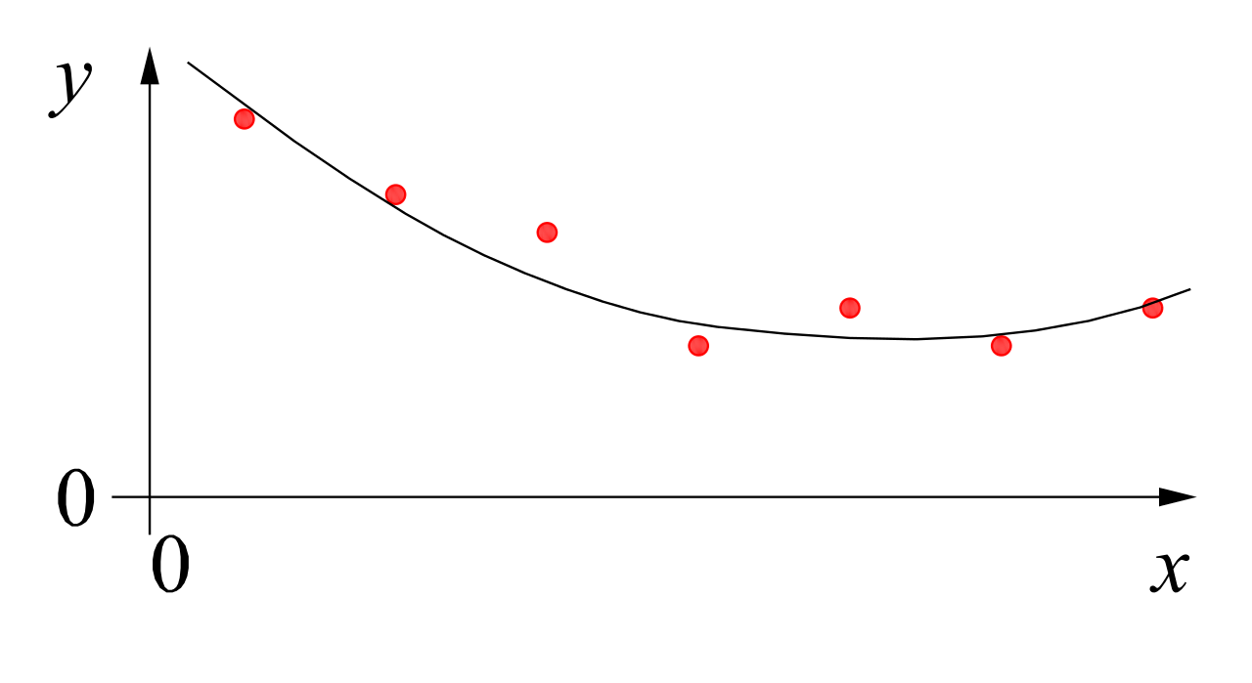


MACHINE LEARNING
no supervision, but goal-based interaction with environment
training target available (labeled or past data)
data not labeled in any way
SUPERVISED
REINFORCEMENT LEARNING
UNSUPERVISED
CLASSIFICATION
ASSOCIATION
CLUSTERING
LEARN STATE OR ACTION VALUES
LEARN POLICY DIRECTLY
REGRESSION
DIMENSIONALITY REDUCTION
SELF-SUPERVISED
learning by teacher
(high-dimensional curve fitting)
learning by observation
(pattern recognition)
learning by trial-and-error
(sequential decision making)
unsupervised and reinforcement learning can both be cast as supervised-learning setup

Slide 5
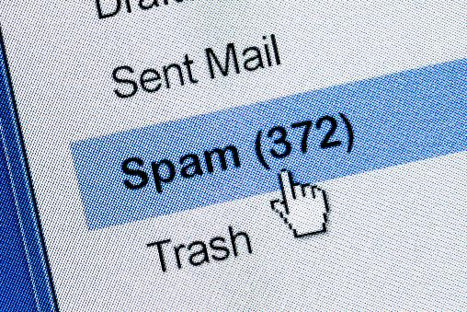
Supervised Learning
Target Quantity
Features
known in training: labeled samples or observations from past
to be predicted for unknown cases (e.g., future values)
(prepared) input information that is
correlated to target quantity
known at prediction time
features x1 and x2 spam, no spam
decision boundary
Example: Spam Filtering
classify emails as spam or no spam
use information like occurrence of specific words or email length as features
use accordingly labeled emails as training set

Slide 6
Optimization

Slide 7
General Recipe of Statistical Learning
ML algorithm by combining:
model (e.g., linear function & Gaussian distribution)
objective function (e.g., squared residuals)
optimization algorithm (e.g., gradient descent)
regularization (e.g., L2, dropout)

Slide 8
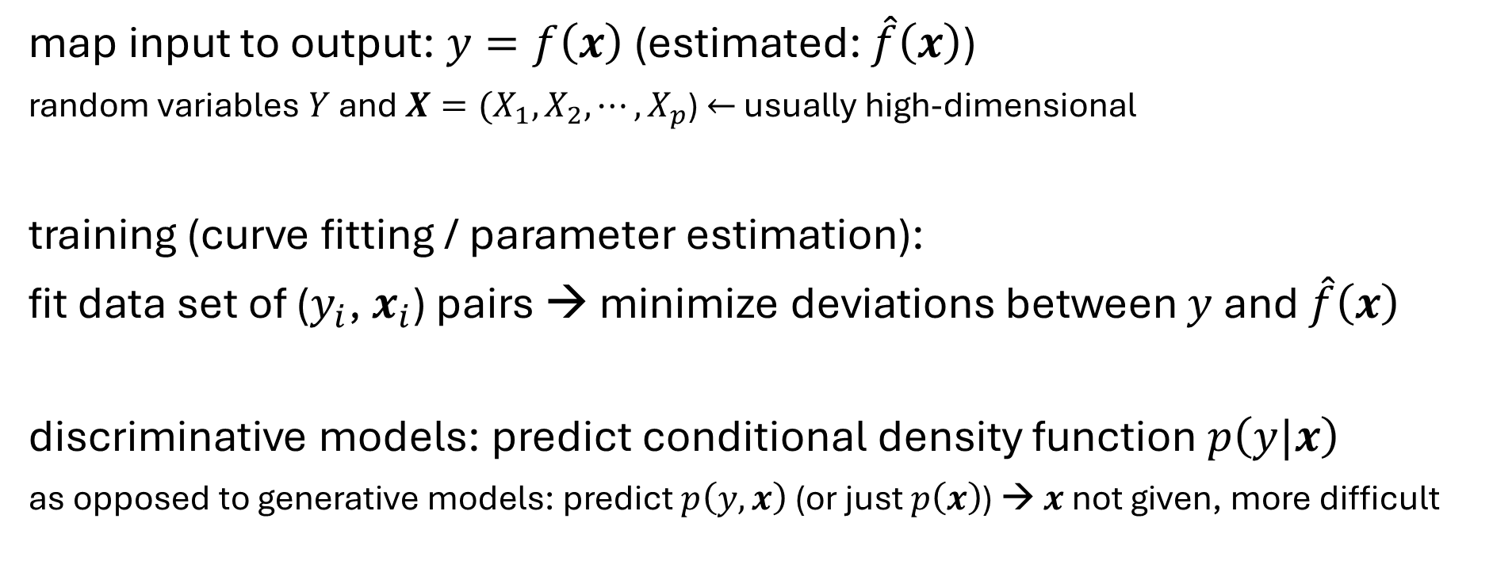
Supervised Learning in Mathematical Terms
map input to output: $y=f\left(x\right)$ (estimated: $\hat{f}\left(x\right)$)
random variables $Y$ and $X={(X}_{1}, X_{2},{⋯,X}_{p}$) $←$ usually high-dimensional
training (curve fitting / parameter estimation):
fit data set of ($y_{i}$, $x_{i}$) pairs → minimize deviations between $y$ and $\hat{f}\left(x\right)$
discriminative models: predict conditional density function $p\left(y|x\right)$
as opposed to generative models: predict $p\left(y, x\right)$ (or just $p\left(x\right)$) → $x$ not given, more difficult

Slide 9
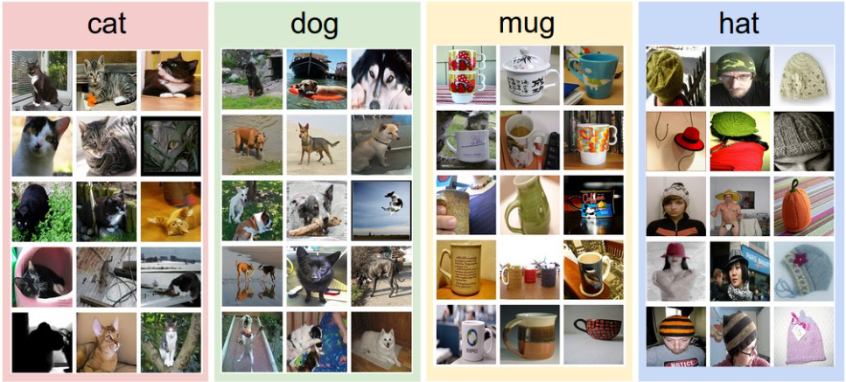
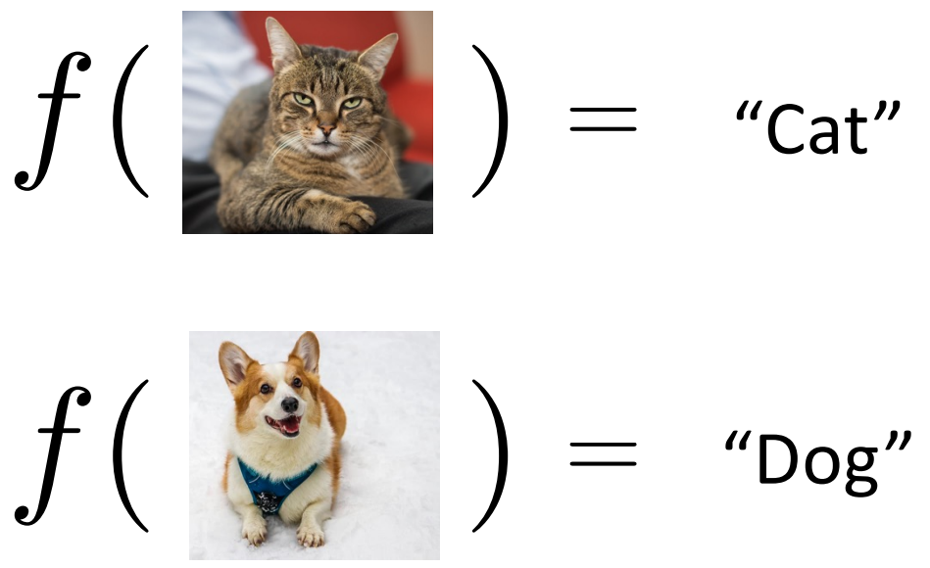
Example: Image Classification
training data set:
test data with learned classifier:
labels:

Slide 10

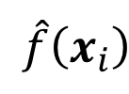
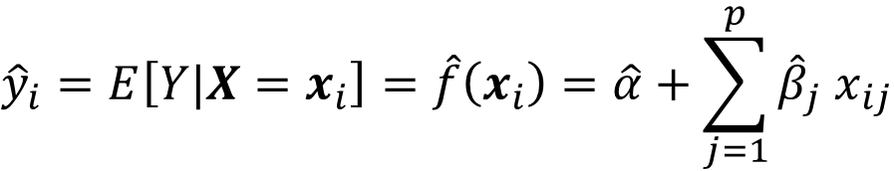
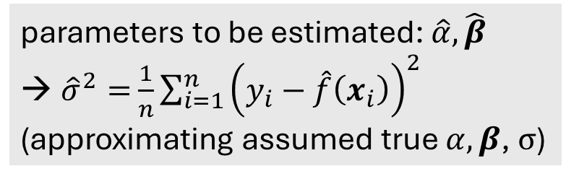
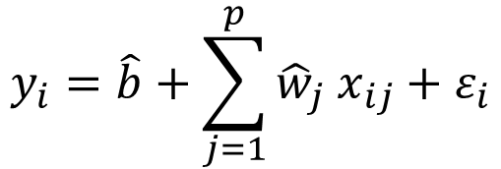
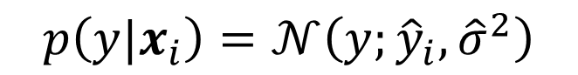
Linear Regression
$$\hat{f}\left(x_{i}\right)$$
fit:
$$y_{i}=\hat{b}+\sum_{j=1}^{p}{{\hat{w}}_{j} x_{ij}}+ε_{i}$$
parameter estimation:
e.g., least squares
Gaussian
predict:
$${\hat{y}}_{i}=E\left[Y|X=x_{i}\right]=\hat{f}\left(x_{i}\right)=\hat{α}+\sum_{j=1}^{p}{{\hat{β}}_{j} x_{ij}}$$
parameters to be estimated: $\hat{α},\hat{β}$
${\hat{σ}}^{2}=$ $\frac{1}{n}\sum_{i=1}^{n}{{\left(y_{i}−\hat{f}\left(x_{i}\right)\right)}^{2}}$
(approximating assumed true $α, β$, $σ$)
$$p\left(y|x_{i}\right)=𝒩\left(y;{\hat{y}}_{i}, {\hat{σ}}^{2}\right)$$
Gaussian
mean
variance

Slide 11
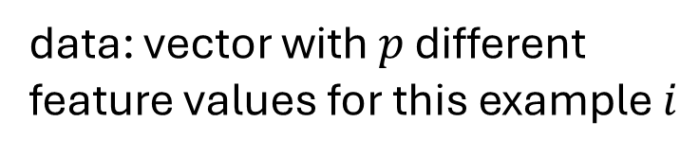
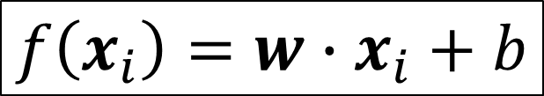
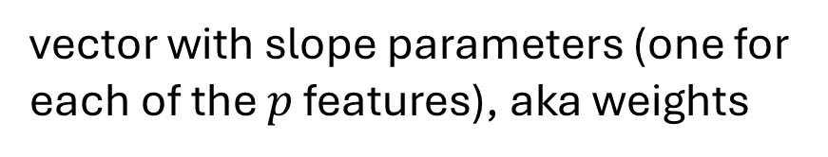
Brief Notation
data: vector with $p$ different feature values for this example $i$
$$f\left(x_{i}\right)=w∙x_{i}+b$$
vector with slope parameters (one for each of the $p$ features), aka weights
intercept parameter, aka bias
for simplicity of notation, dropping the hats of estimated parameters from now on

Slide 12
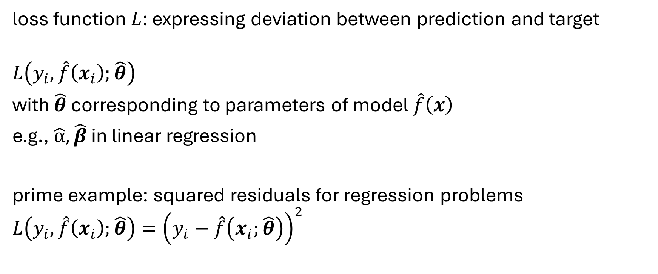
Loss Function
loss function $L$: expressing deviation between prediction and target
$$L\left(y_{i},\hat{f}\left(x_{i}\right);\hat{θ}\right)$$
with $\hat{θ}$ corresponding to parameters of model $\hat{f}\left(x\right)$
e.g., $\hat{α}, \hat{β}$ in linear regression
prime example: squared residuals for regression problems
$$L\left(y_{i},\hat{f}\left(x_{i}\right);\hat{θ}\right)={\left(y_{i}−\hat{f}\left(x_{i};\hat{θ}\right)\right)}^{2}$$

Slide 13
Cost Function
averaging losses over (empirical) training data set:
$$J\left(\hat{θ}\right)=\frac{1}{n}\sum_{i=1}^{n}{L\left(y_{i},\hat{f}\left(x_{i}\right);\hat{θ}\right)}$$
cost function to be minimized according to model parameters $\hat{θ}$
→ objective function

Slide 14
Cost Minimization
minimize training costs $J\left(\hat{θ}\right)$ according to model parameters $\hat{θ}$:
$∇_{\hat{θ}} J\left(\hat{θ}\right)=0$
for mean squared error (aka least squares method):
$∇_{\hat{θ}} \frac{1}{n}\sum_{i=1}^{n}{{\left(y_{i}−\hat{f}\left(x_{i};\hat{θ}\right)\right)}^{2}}=0$

Slide 15
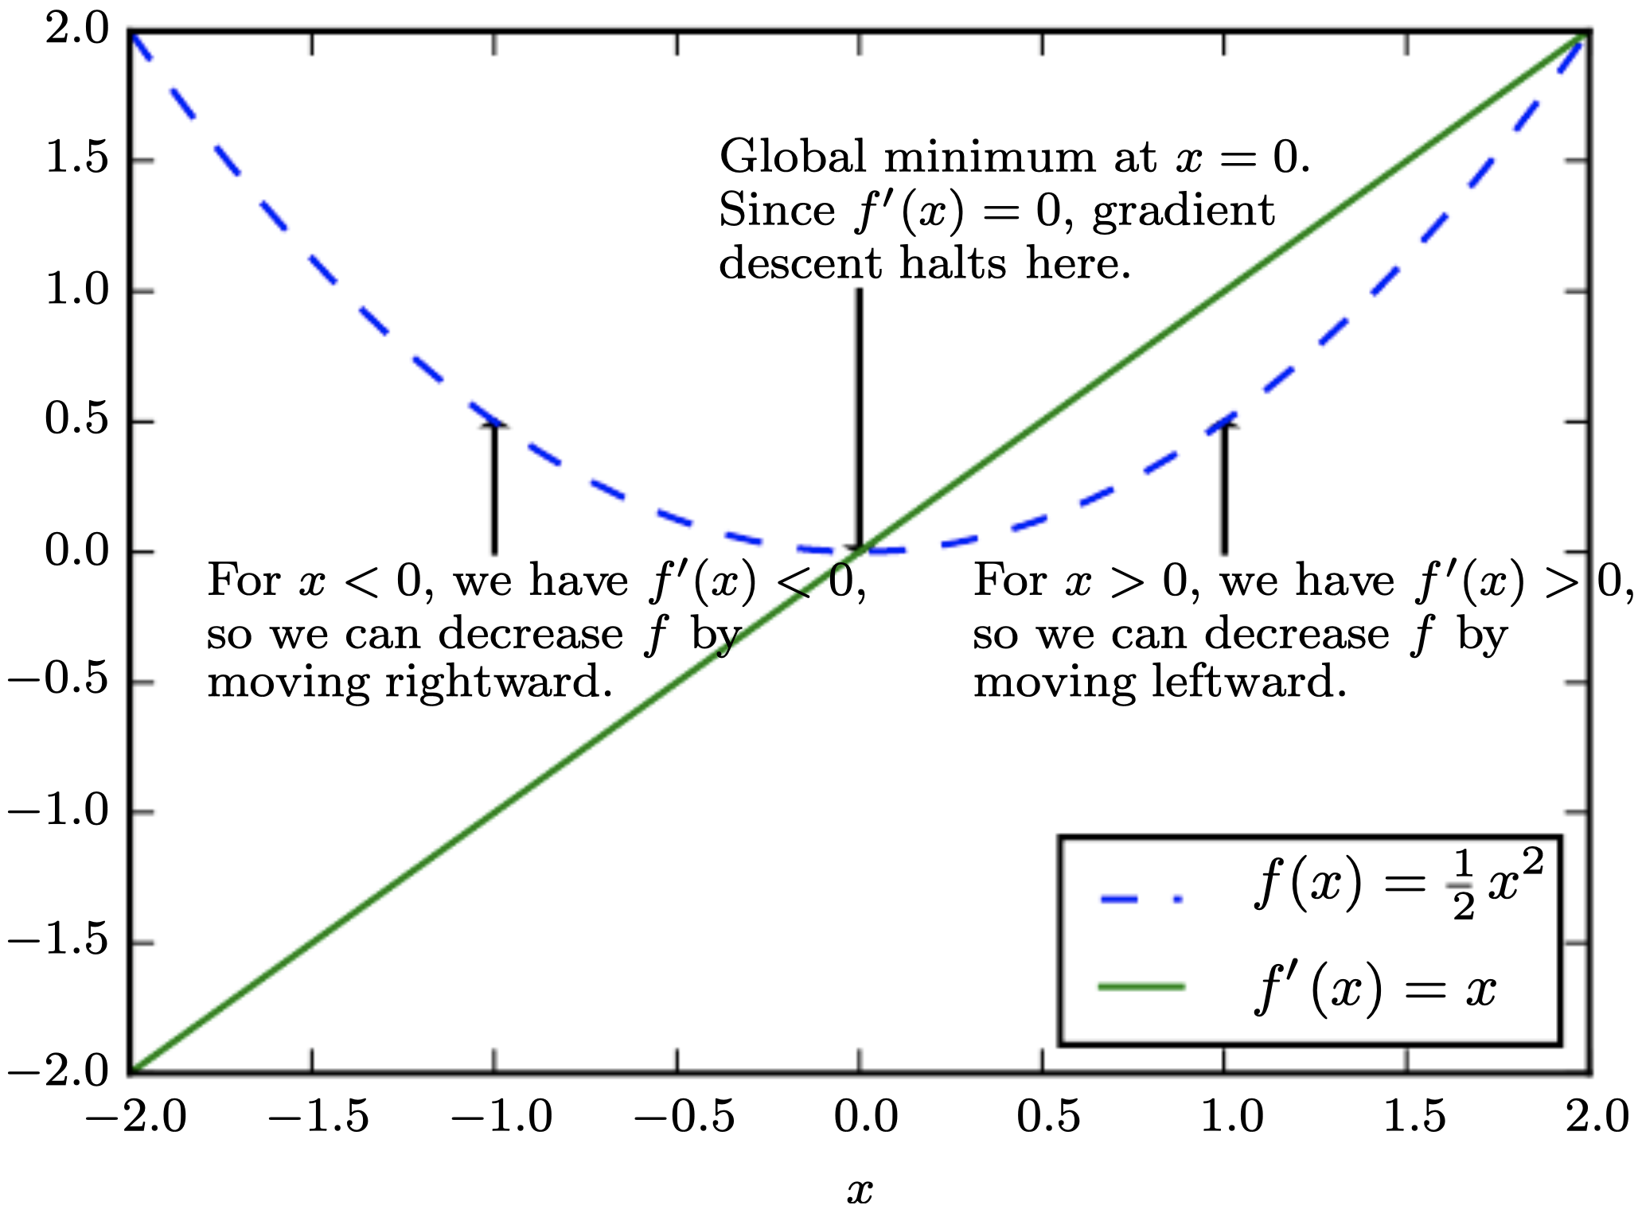
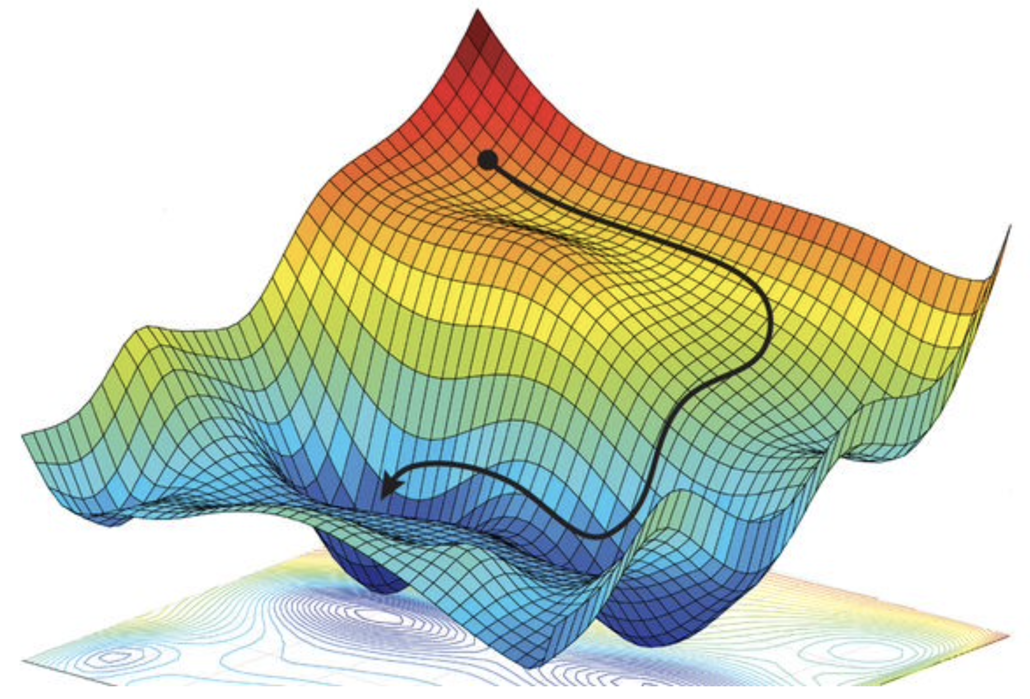
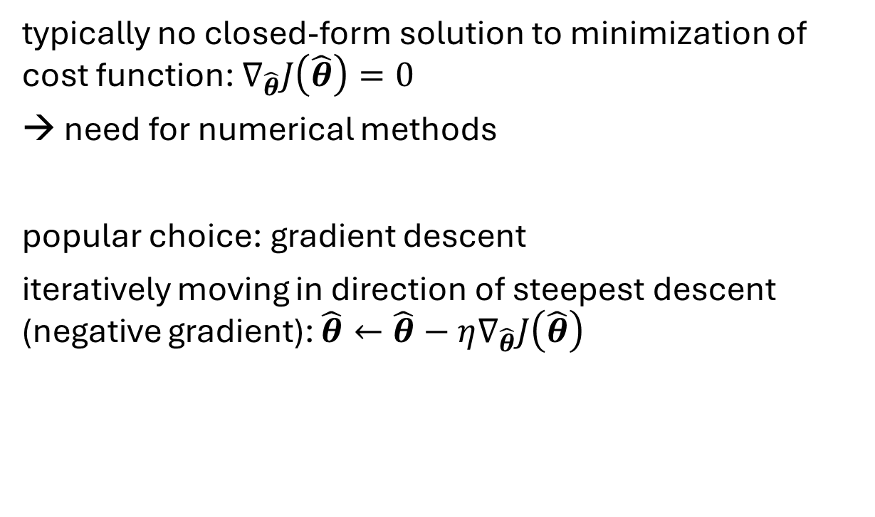
Gradient Descent
typically no closed-form solution to minimization of cost function: $∇_{\hat{θ}}J\left(\hat{θ}\right)=0$
need for numerical methods
popular choice: gradient descent
iteratively moving in direction of steepest descent (negative gradient): $\hat{θ}←\hat{θ}−η∇_{\hat{θ}}J\left(\hat{θ}\right)$
source
local minimum
global minimum
step size (learning rate)
vector containing all partial derivatives

Slide 16
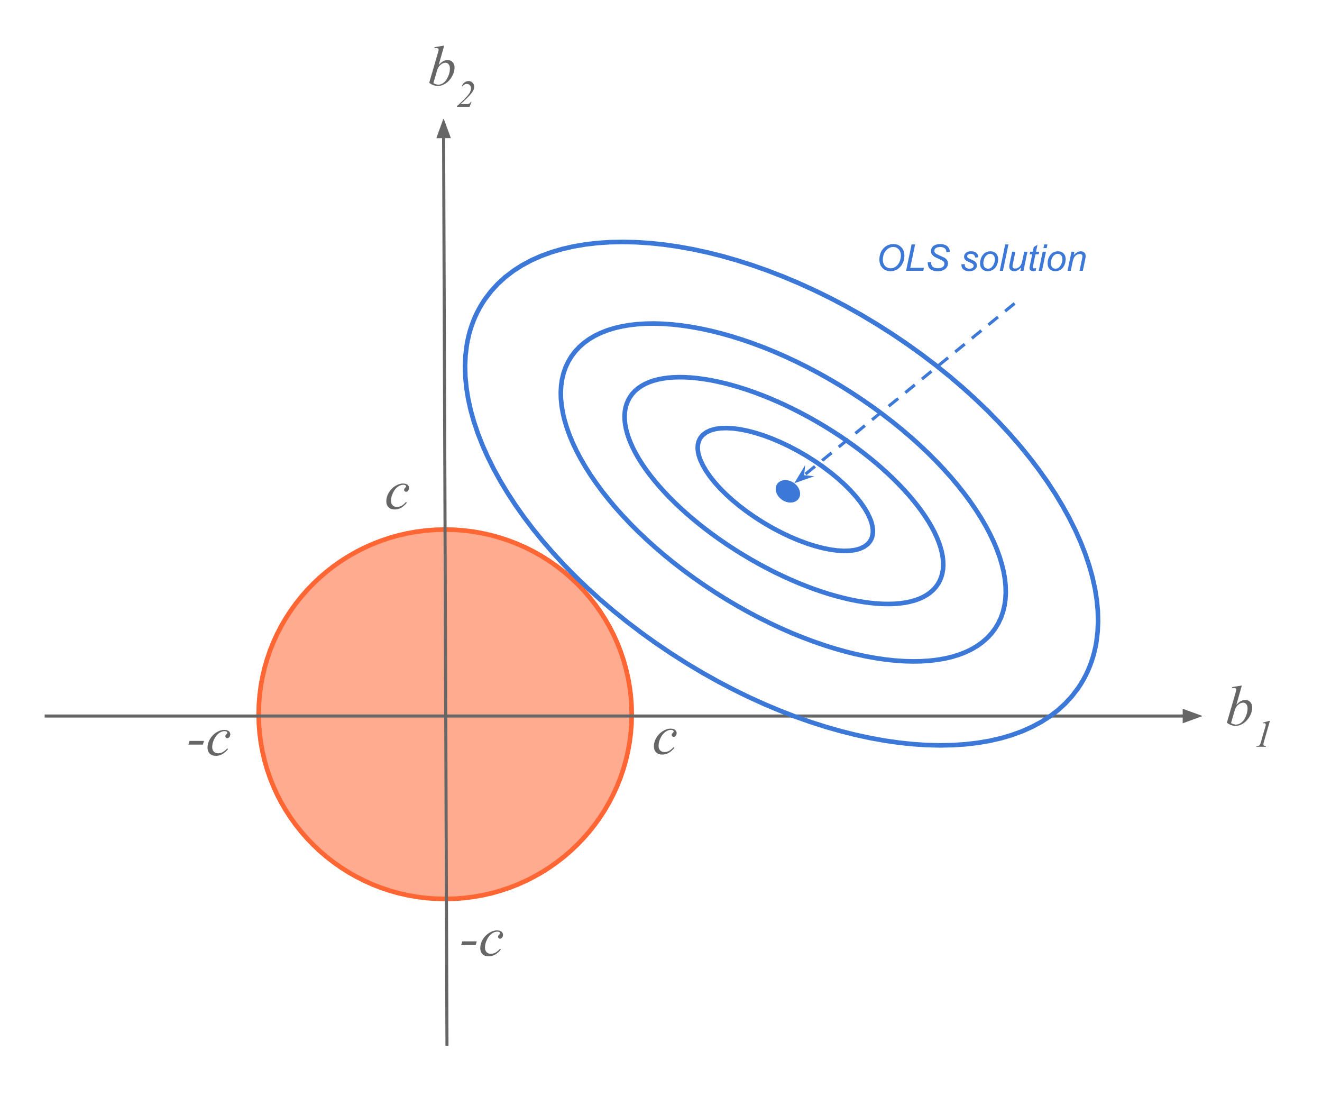
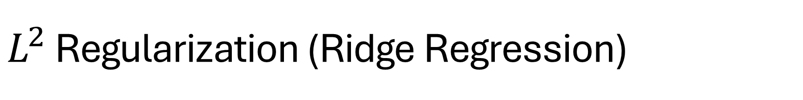
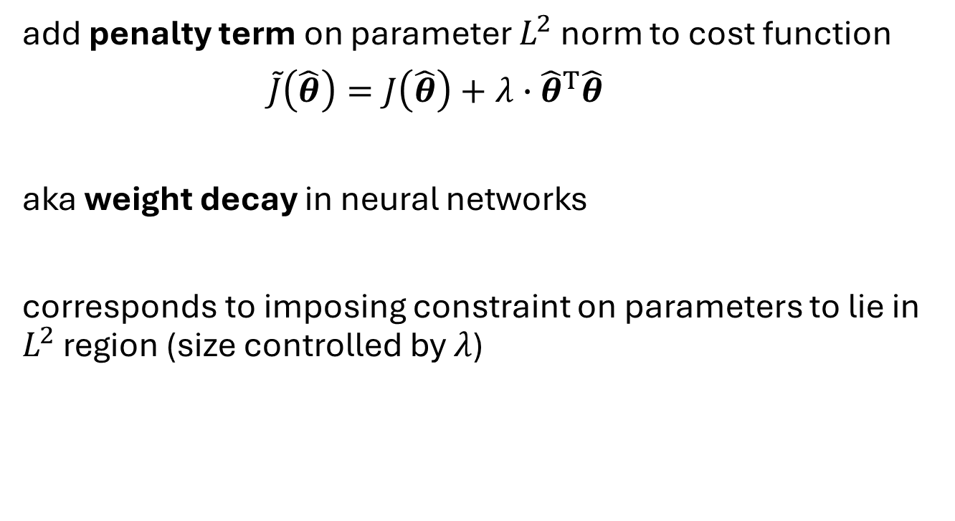
$L^{2}$ Regularization (Ridge Regression)
add penalty term on parameter $L^{2}$norm to cost function
$\tilde{J}\left(\hat{θ}\right)=J\left(\hat{θ}\right)+λ∙{\hat{θ}}^{T}\hat{θ}$
aka weight decay in neural networks
corresponds to imposing constraint on parameters to lie in $L^{2}$ region (size controlled by $λ$)
hyperparameter controlling strength of regularization
source

Slide 17
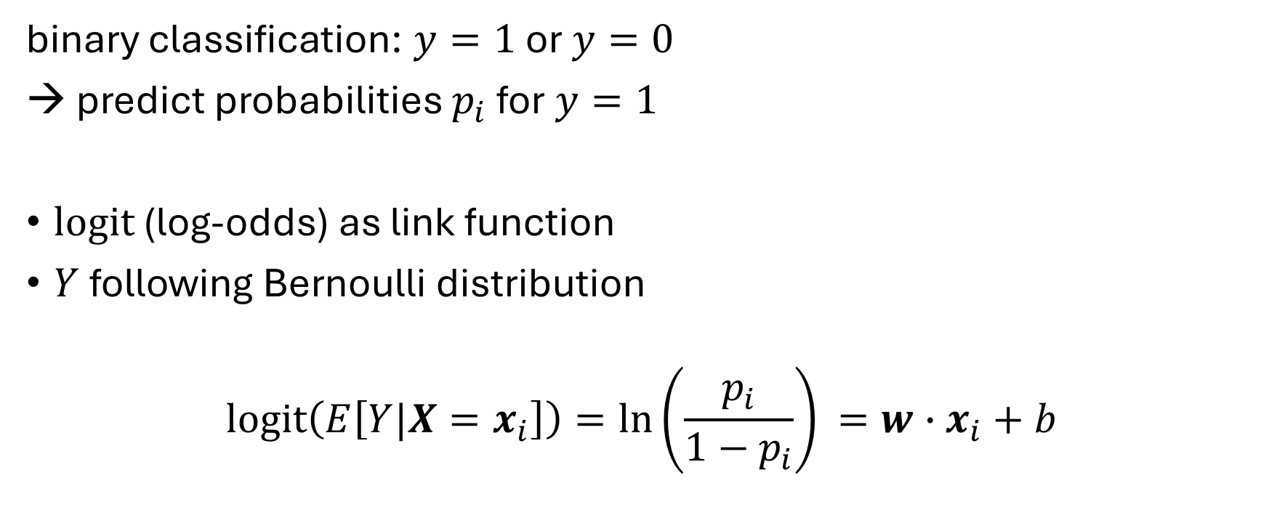
Classification: Logistic Regression
binary classification: $y=1$ or $y=0$
→ predict probabilities $p_{i}$ for $y=1$
logit (log-odds) as link function
$Y$ following Bernoulli distribution
$$\operatorname{logit}\left(E\left[Y|X=x_{i}\right]\right)=\ln\left(\frac{p_{i}}{1−p_{i}}\right)⁡=w∙x_{i}+b$$

Slide 18
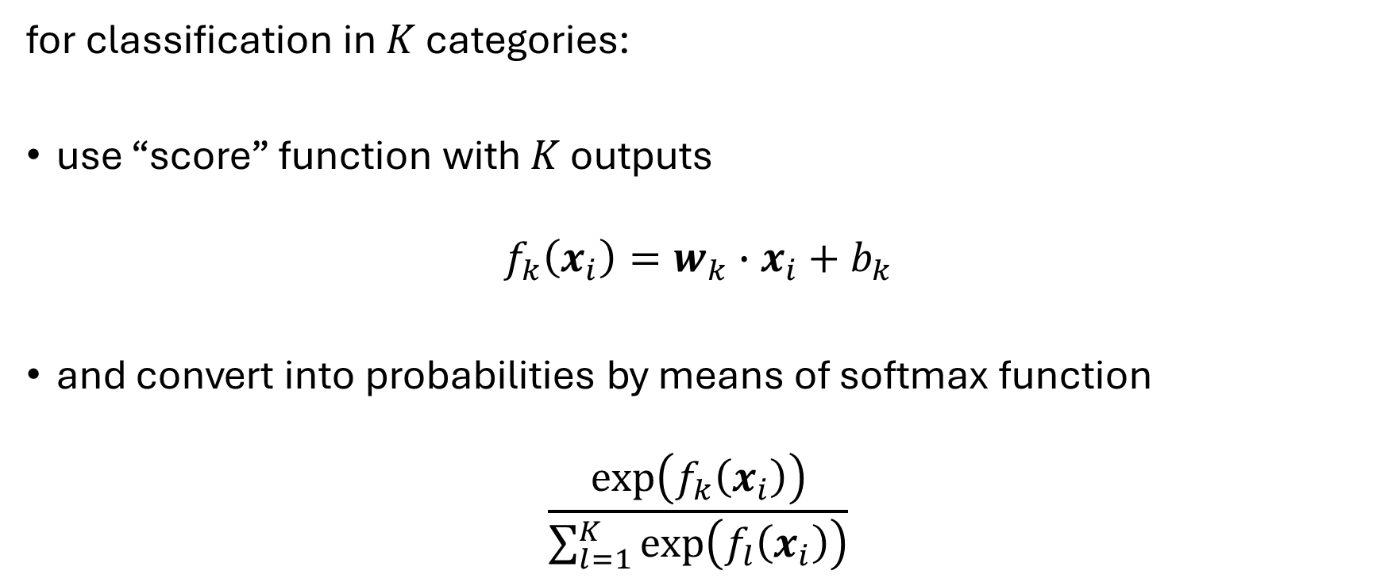
Multi-Classification: Softmax
for classification in $K$ categories:
use “score” function with $K$ outputs
$$f_{k}\left(x_{i}\right)=w_{k}∙x_{i}+b_{k}$$
and convert into probabilities by means of softmax function
$$\frac{\exp\left(f_{k}\left(x_{i}\right)\right)}{\sum_{l=1}^{K}{\exp\left(f_{l}\left(x_{i}\right)\right)}}$$

Slide 19
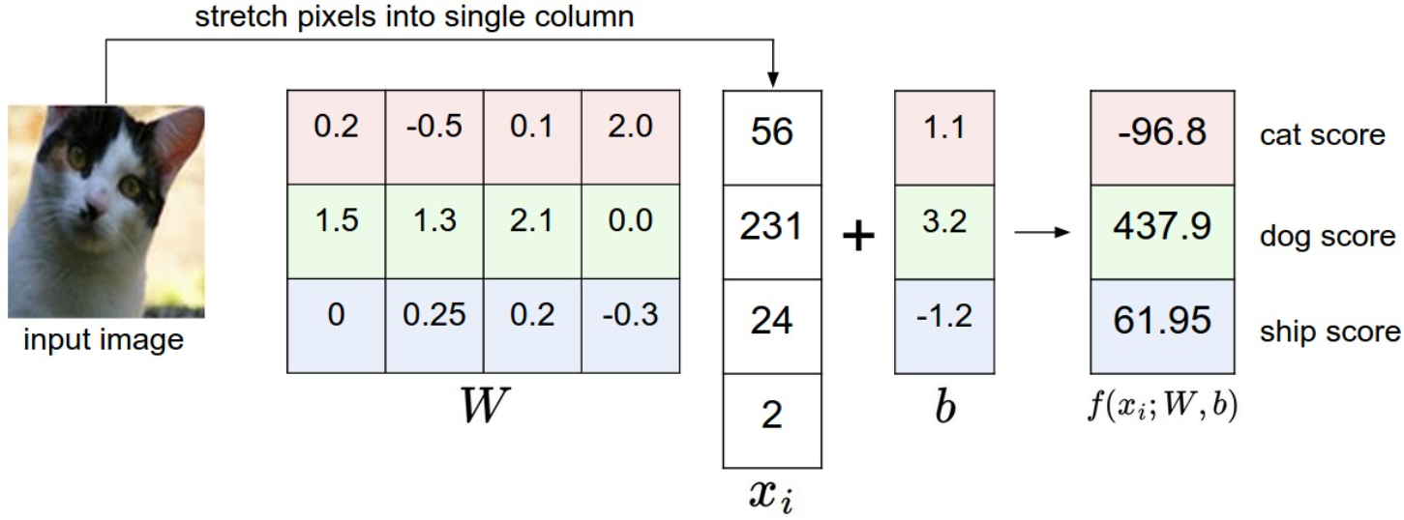
Image Classification with Linear Regression
simplified example: 4-pixel image, 3 classes
matrix
intensity values
need for one common image size per model

Slide 20
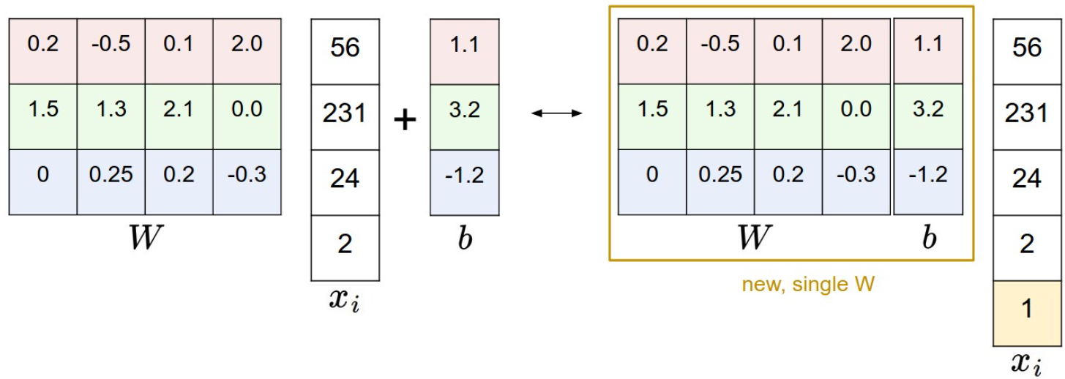
Simplified Matrix Multiplication: Bias Trick

Slide 21
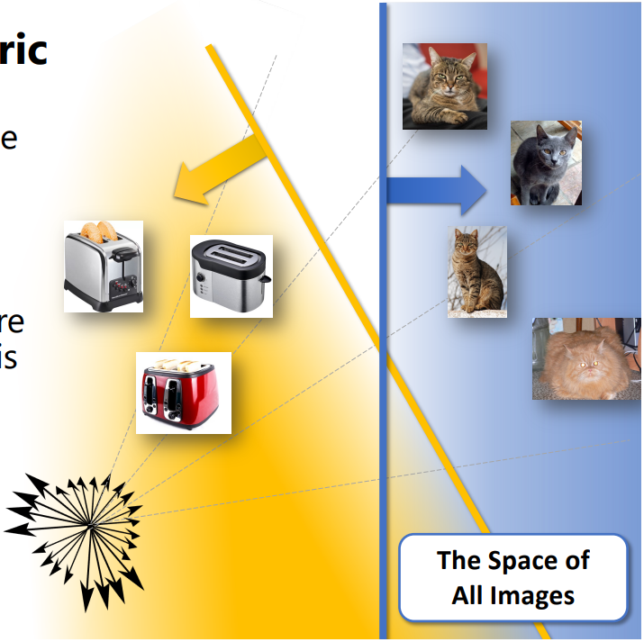
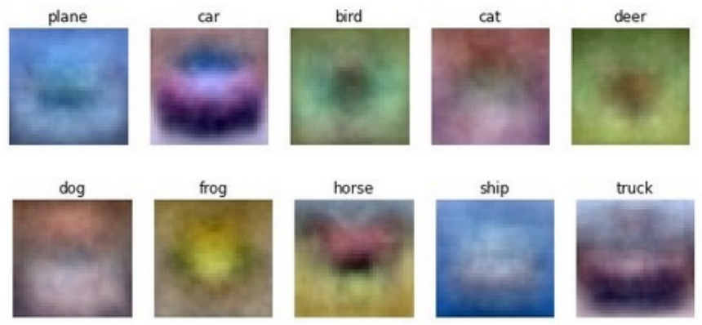
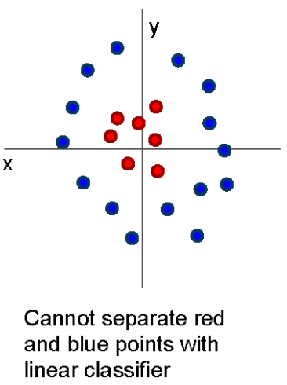
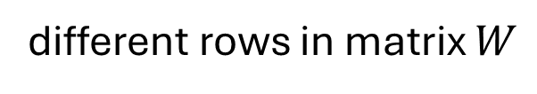
geometric interpretation:
separating hyperplanes
matching interpretation:
generic class templates
different rows in matrix $W$
raw-pixel images not linearly separable
→ linear model has not enough representational power

Slide 22
Need for Generalization

Slide 23
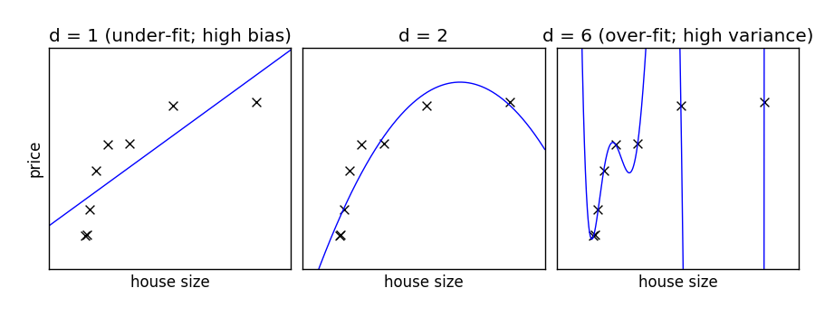
Under- and Over-Fitting
example: polynomial fit
need to predict new samples (not in training data set): interpolation
degree of fitted polynomial

Slide 24
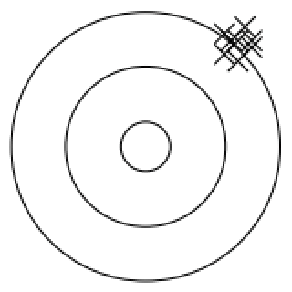
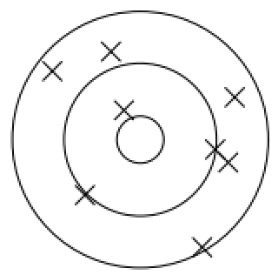
Bias, Variance, Irreducible Error
think of fitting ML algorithms as repeatable processes with different data sets
irreducible error (aka Bayes error):
inherent randomness (target generated from random variable)
limiting accuracy of ideal model
bias
due to too simplistic model (same for all training data sets)
“underfitting”
variance
due to sensitivity to specifics (noise) of different training data sets
“overfitting”

Slide 25
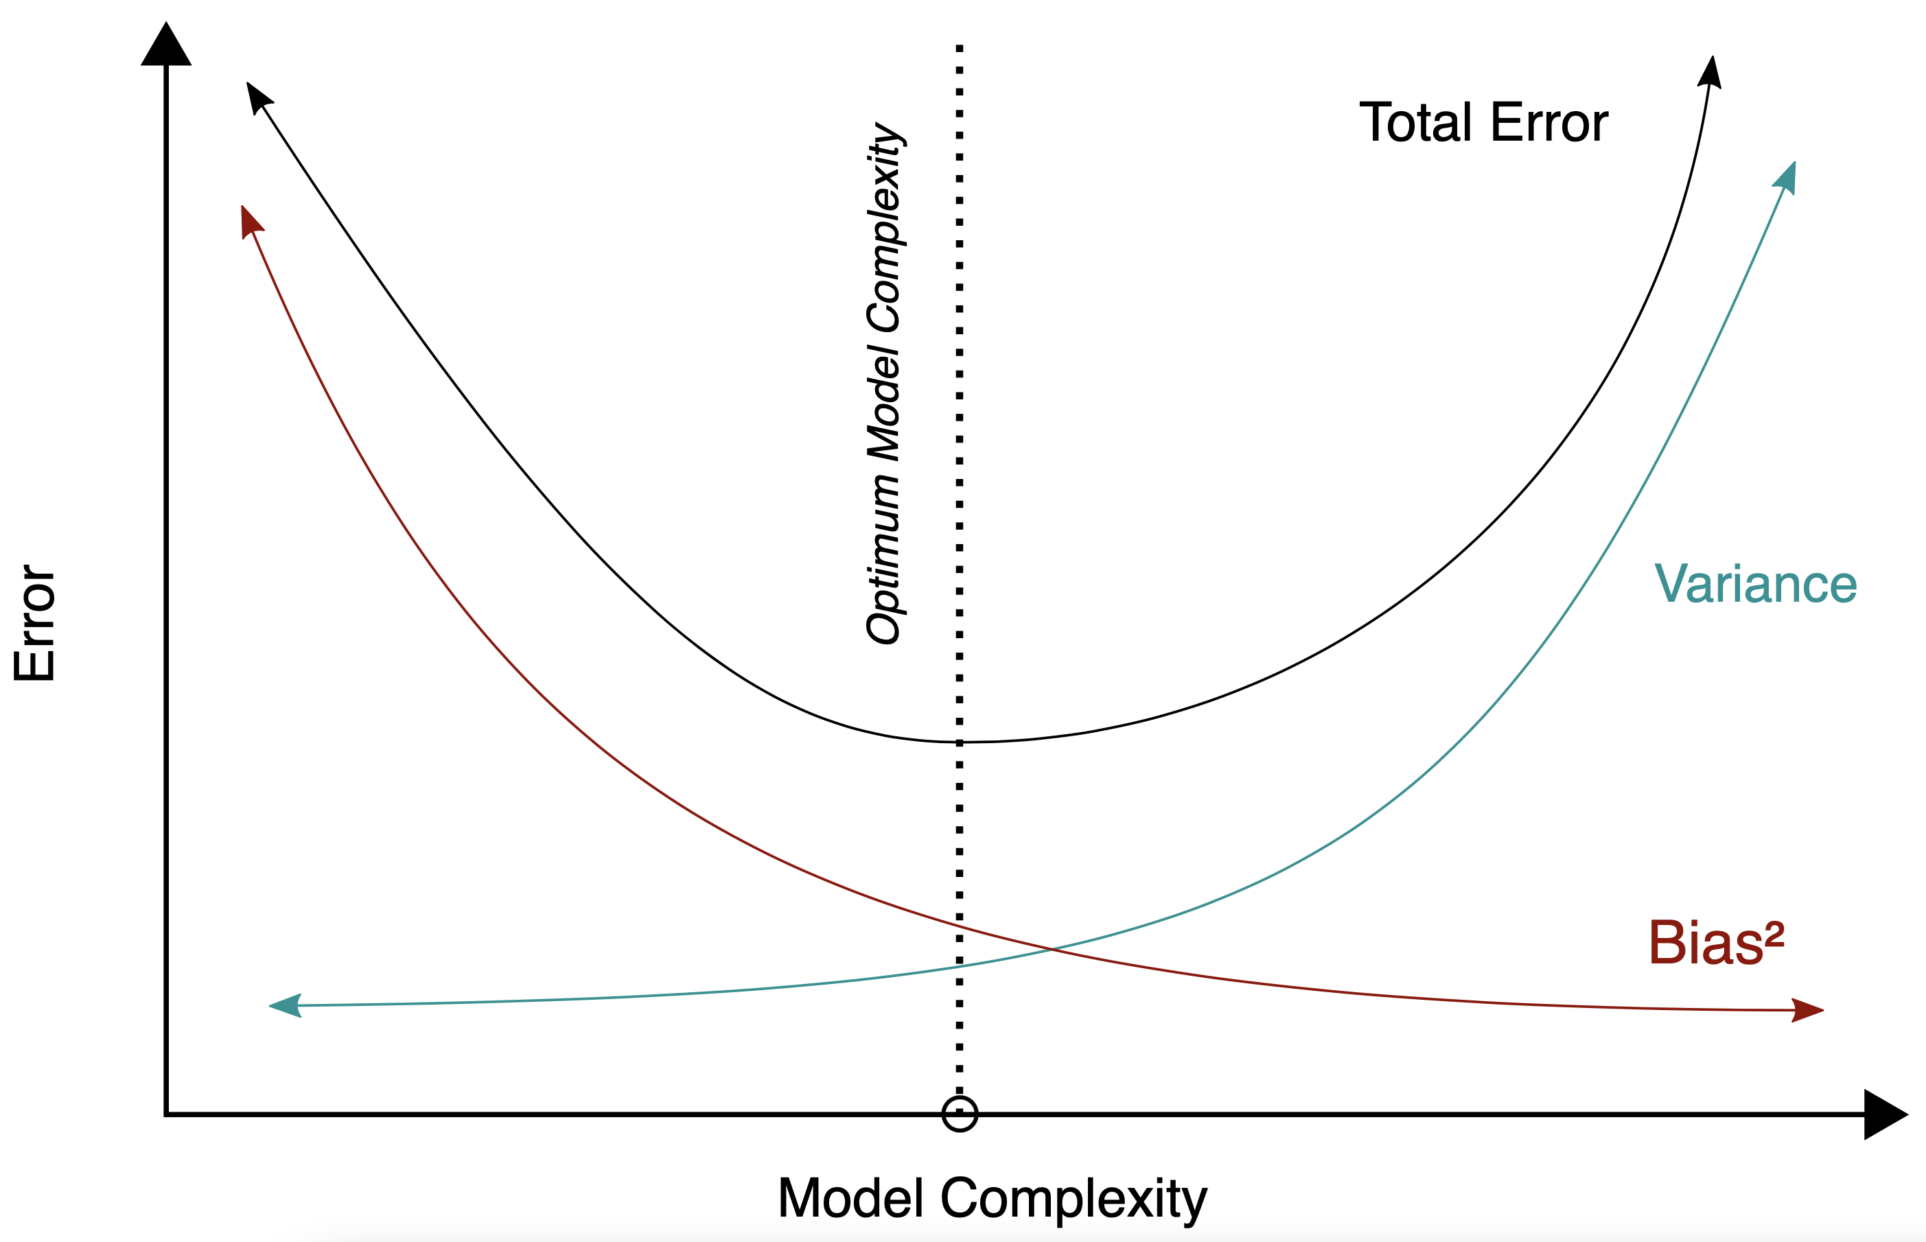
Bias-Variance Tradeoff
models of higher complexity have lower bias but higher variance
(given the same number of training examples)
generalization error follows U-shaped curve: overfitting once model complexity (number of parameters) passes certain threshold
overfitting: variance term dominating test error
→ increasing model complexity increases test error
but beware: training error keeps decreasing with more complex model …

Slide 26
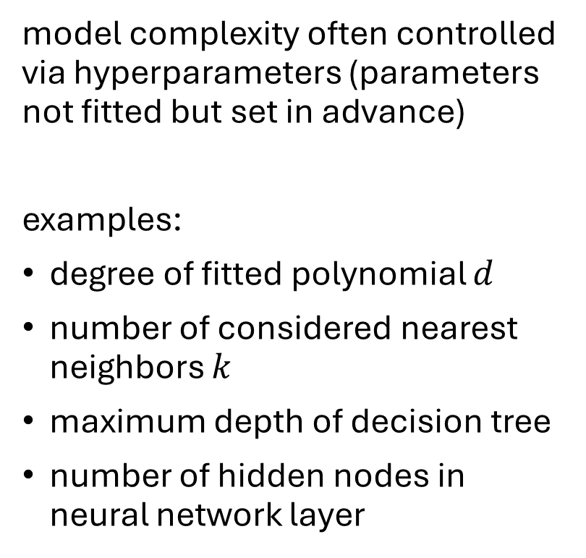
Hyperparameters
model complexity often controlled via hyperparameters (parameters not fitted but set in advance)
examples:
degree of fitted polynomial $d$
number of considered nearest neighbors $k$
maximum depth of decision tree
number of hidden nodes in neural network layer
hyperparameter tuning

Slide 27
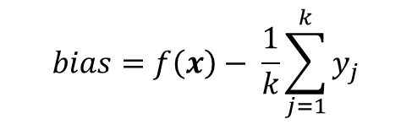
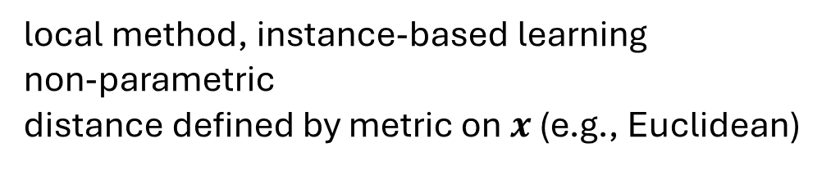
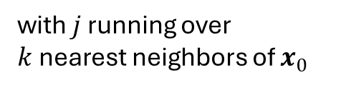
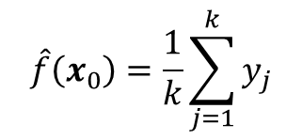
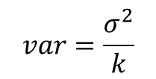
Another Example: k-Nearest Neighbors (kNN)
local method, instance-based learning
non-parametric
distance defined by metric on $x$ (e.g., Euclidean)
regression:
$$\hat{f}\left(x_{0}\right)=\frac{1}{k}\sum_{j=1}^{k}{y_{j}}$$
with $j$ running over $k$nearest neighbors of $x_{0}$
low k: low bias but high variance
high k: low variance but high bias
$$bias=f\left(x\right)− \frac{1}{k}\sum_{j=1}^{k}{y_{j}}$$
$$var=\frac{σ^{2}}{k}$$

Slide 28
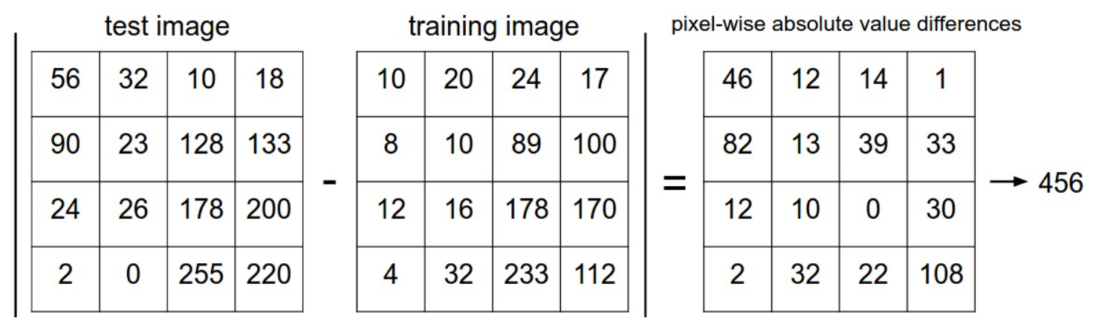
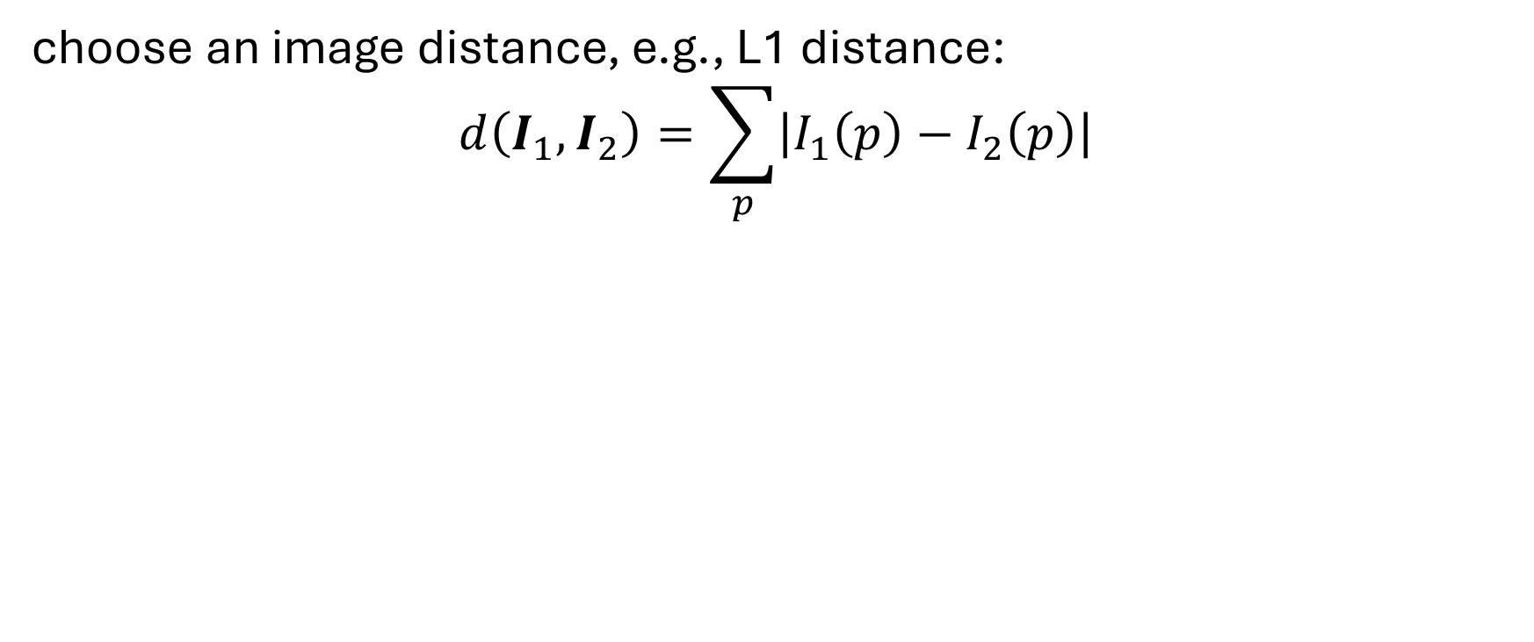
Image Classification with kNN
choose an image distance, e.g., L1 distance:
$$d\left(I_{1},I_{2}\right)=\sum_{p}{\left|I_{1}\left(p\right)−I_{2}\left(p\right)\right|}$$

Slide 29
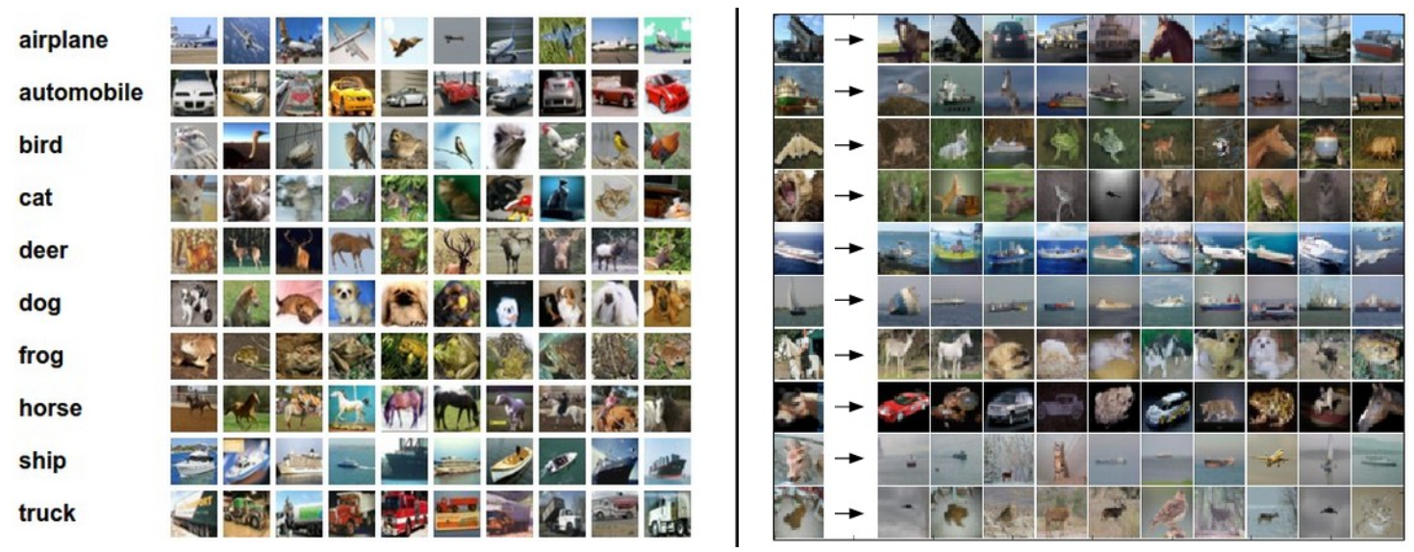
Image Classification with kNN
training examples CIFAR-10 data set
10 nearest neighbors to some test images
10 classes
better than random guessing, but also not very impressive

Slide 30

Algorithmic Families of Supervised Learning
parametric models
nearest neighbors (local methods, instance-based learning):
non-parametric models
decision trees:
rule learning
linear regression
Day
neural networks: many linear models, non-linear by means of activation functions
Weekday
Weekend
3
Promo
No
Yes
demand prediction
5
8
often used in ensemble methods
bagging: random forests
boosting: gradient boosting
kernel/support-vector machines: linear model (maximum-margin hyperplane) with kernel trick

Slide 31
Common Idea: Learning from Data
ML algorithm + data = explicit algorithm
much better generalizability than handcrafted algorithms
unfortunately, no general best ML algorithm:
need to pick right method for the task at hand

Slide 32
Generalization
core of ML: empirical risk minimization (training error) as proxy for minimizing unknown population risk (test error)
generalization gap: difference between test and training error
curse of dimensionality: typically, many features (dimensions)
→ lots of data needed to densely sample volume

Slide 33
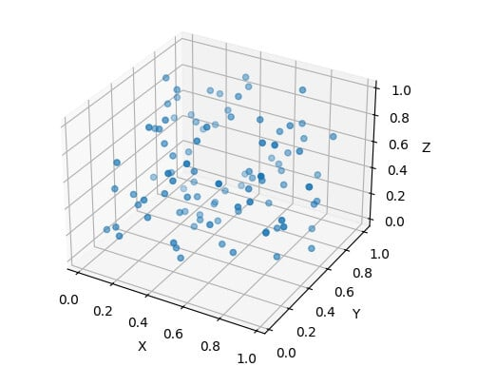
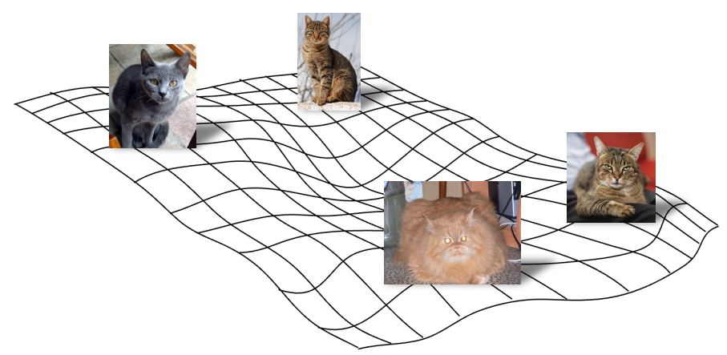
Manifold Hypothesis
luckily, reality is friendly: most high-dimensional data sets reside on lower-dimensional manifolds → enabling effectiveness of ML

Slide 34
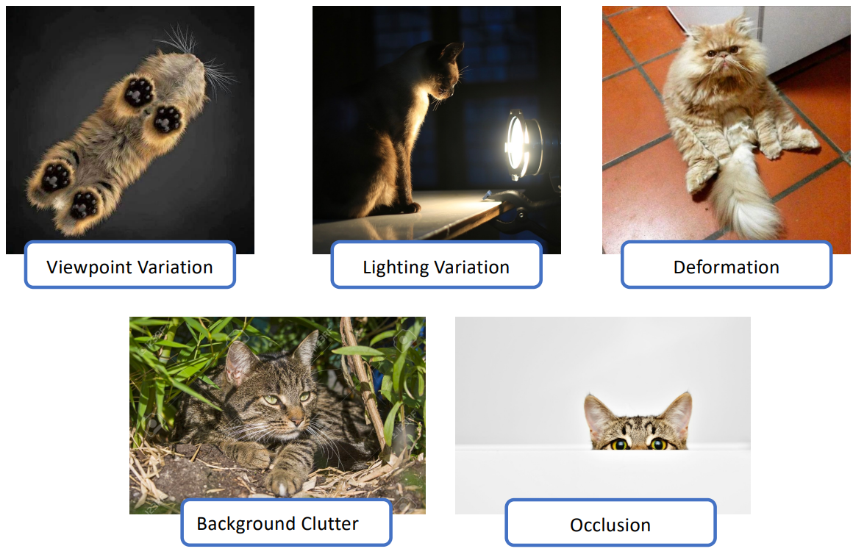
Which Features for Image Classification?
challenges:
linear regression & kNN (same for tree-based methods):
learning directly from raw pixel intensities does not work great
→ try learning from pre-extracted features, such as HOG or SIFT

Slide 35
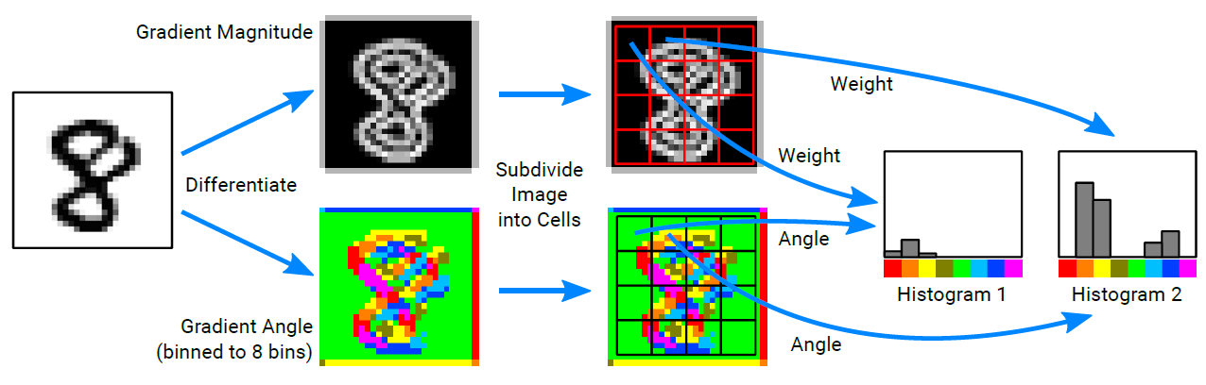
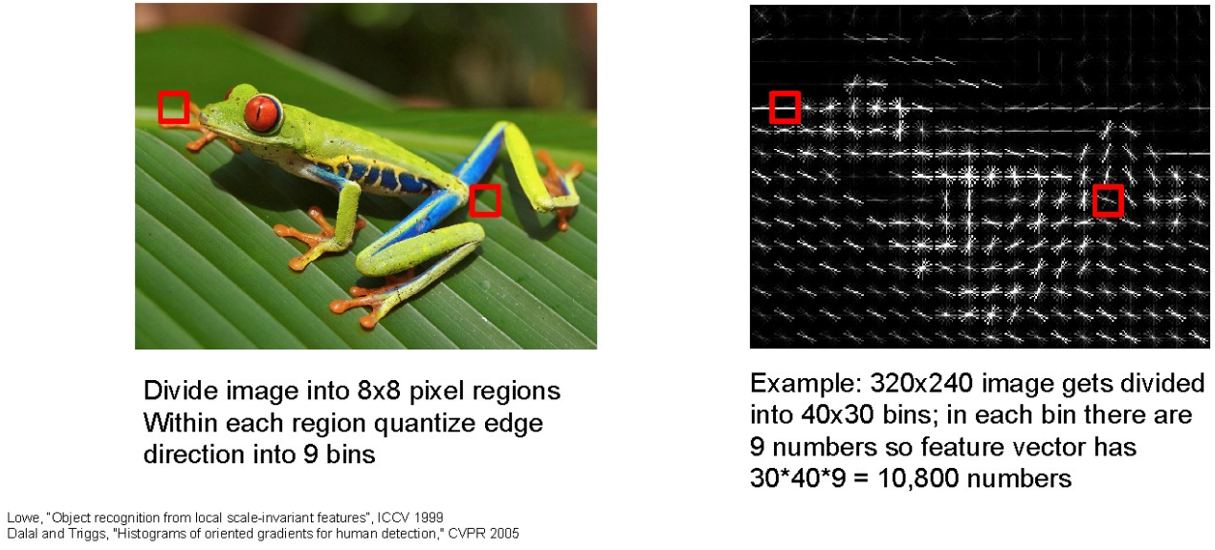

Global Features in Classic ML Method
often used: HOG
features covering entire image (instead of only local patches)
or random forest, support-vector machine, …
easier to separate than raw pixels
important disadvantage: not translation invariant (due to ordering of patches)

Slide 36

Local Features in Classic ML Method
local features like SIFT do not cover the entire image
→ need for some processing to identify features in different images (to be able to compare different images with ML)
in HOG this is done by ordering of patches making up the complete image
one popular approach, called bag-of-words model (as it is orderless):
learn clustering of SIFT vectors (e.g., with K-means)
quantization of different clusters into visual “vocabulary” (see embeddings in language models)
create (sparse) histogram of visual “word” occurrences
train ML model (e.g., random forest) with histogram bins as features
important disadvantage: ignores spatial relationships among different patches

Slide 37
Need for Feature Learning
many hand-designed components in approach using pre-extracted features → poor generalization
Is there maybe some way after all to learn features end-to-end from raw pixel intensities?

Slide 38
Deep Learning

Slide 39



Ladder of Generalization
classic ML: feature engineering
deep learning: feature learning
(hierarchy of concepts learned from raw data in deep graph with many layers)
source
source
source

Slide 40
Neural Networks
idea: powerful algorithm by combining many linear building blocks
each node exchanges information only with directly connected nodes → parallel computation

Slide 41




Artificial Neuron
artificial neuron (node in neural network):
linear model with parameters called weights $w$ (including bias, not shown for simplicity)
non-linear via (differentiable) activation function on top of linear model
examples:
sigmoid
ReLU (Rectified Linear Unit)
inspired from biological neurons:
source

Slide 42

Multi-Layer Perceptron (MLP)
fully-connected feed-forward network with at least one hidden layer (universal function approximator)
toward deep learning: add hidden layers
more layers (depth) more efficient than just more nodes (width): less parameters needed for same function complexity
binary classification
regression

Slide 43

Classification Networks
cross-entropy loss:
$$L_{i}\left(y_{i},\hat{f}\left(x_{i}\right);\hat{w}\right)=−\sum_{k=1}^{K}{y_{ik}\log{{\hat{f}}_{k}\left(x_{i};\hat{w}\right)}}$$
one output node for each class $k$
softmax on outputs $t$of final-layer nodes:
$$g_{k}\left(t_{i}\right)=\frac{e^{t_{ik}}}{\sum_{l=1}^{K}{e^{t_{il}}}}$$
regression networks:
squared error loss
just one output node
identity output function

Slide 44

Image Classification: Lots of Categories

Slide 45

Find Gradients for (Deep) Neural Networks
backpropagation of errors through network layers via chain rule of calculus (enables learning of deep neural networks)
forward pass:
fix current weights
compute predictions
backward pass:
compute errors
calculate gradients (backpropagation of errors)
update weights accordingly (gradient descent)
source

Slide 46


Example WOLOG
error measured here,
but not here
regression (squared error loss, identity output function $g$)
with one hidden layer ($\hat{w}$: $\hat{α}$, $\hat{β}$)
$${\hat{y}}_{i}=\hat{f}\left(x_{i};\hat{w}\right)=g\left(z_{i};\hat{β}\right)=\sum_{k=0}^{q}{{\hat{β}}_{k}z_{ik}}$$
$$z_{ik}=h\left(x_{i};{\hat{α}}_{k}\right)=h\left(\sum_{j=0}^{p}{{\hat{α}}_{kj}x_{ij}}\right)$$
cost function:
$$J\left(\hat{w}\right)=\sum_{i=1}^{n}{L_{i}\left(y_{i},\hat{f}\left(x_{i}\right);\hat{w}\right)}=\sum_{i=1}^{n}{{\left(y_{i}−\hat{f}\left(x_{i};\hat{α}\text{, }\hat{β}\right)\right)}^{2}}$$
$$z_{1}$$
$p$ inputs
$$α_{1j}$$
$$z_{2}$$
$$x_{1}$$
$$z_{3}$$
$$y$$
$$x_{2}$$
$$z_{4}$$
activation function
$$α_{5j}$$
$$β_{k}$$
$$α_{kj}$$
$$z_{5}$$
$q$ nodes in hidden layer

Slide 47

Example WOLOG
gradients:
$$\frac{∂L_{i}}{∂{\hat{β}}_{k}}=−2 \left(y_{i}−\hat{f}\left(x_{i};\hat{w}\right)\right)z_{ik}=δ_{i}z_{ik}$$
$$\frac{∂L_{i}}{∂{\hat{α}}_{kj}}=−2 \left(y_{i}−\hat{f}\left(x_{i};\hat{w}\right)\right){\hat{β}}_{k}h_{k}^{′}\left(\sum_{j=0}^{p}{{\hat{α}}_{kj}x_{ij}}\right)x_{ij}=s_{ik}x_{ij}$$
backpropagation equations: $s_{ik}=h_{k}^{′}\left(\sum_{j=0}^{p}{{\hat{α}}_{kj}x_{ij}}\right){\hat{β}}_{k}δ_{i}$
use errors of later layers to calculate errors of earlier ones (avoiding redundant calculations of intermediate terms)

Slide 48

Using Gradients for Iterative Learning
use gradients found via backpropagation to iteratively update weights (gradient descent):
$${\hat{β}}_{k}^{(r+1)}={\hat{β}}_{k}^{(r)}−η_{r} \sum_{i=1}^{n}{\frac{∂L_{i}}{∂{\hat{β}}_{k}^{\left(r\right)}}} {\hat{α}}_{kj}^{(r+1)}={\hat{α}}_{kj}^{(r)}−η_{r} \sum_{i=1}^{n}{\frac{∂L_{i}}{∂{\hat{α}}_{kj}^{(r)}}}$$
adaptive learning rate $η_{r}$: learning rate often adjusted per iteration
weight initialization: choose small random weights as starting values to break symmetry (typically using some heuristics)

Slide 49

Stochastic Gradient Descent (SGD)
updates $\hat{w}←\hat{w}−η∇_{\hat{w}}J\left(\hat{w}\right)$ can be done with whole training data set ($n$ observations), aka batch, or small random sample:
$J\left(\hat{w}\right)=\frac{1}{n}\sum_{i=1}^{n}{J_{i}\left(\hat{w}\right)}$ batch (or deterministic) gradient descent
$J\left(\hat{w}\right)=J_{i}\left(\hat{w}\right)$ stochastic gradient descent (single example)
$J\left(\hat{w}\right)=\frac{1}{m}\sum_{i=1}^{m}{J_{i}\left(\hat{w}\right)}$ mini-batch stochastic gradient descent (size $m$)
SGD has implicit regularization effect, and its random fluctuations help to escape saddle points
another hyperparameter: mini-batch size (tradeoff between runtime, memory, …)

Slide 50
The Art of Network Training

Slide 51

How to Train Deep Neural Networks Effectively?
optimization and regularization difficult:
non-convex optimization problem (e.g., local vs global minima, saddle points), easily overfitting
many hyperparameters to tune
but many methods to get it working in practice (despite partly patchy theoretical understanding)
typical loss surface:
source
optimization
activation and loss functions
weight initialization
stochastic gradient descent
adaptive learning rate
batch normalization
explicit regularization
weight decay
dropout
data augmentation
weight sharing
implicit regularization
early stopping
batch normalization
stochastic gradient descent

Slide 52


Gradient Descent with Momentum
hyperparameter ($0<α<1$) specifying exponential decay (potentially adaptive)
algorithm:
estimate gradient $g$
compute velocity update: $v ← α v−η g$
apply parameter update: $\hat{θ} ←\hat{θ}+v$
velocity: parameter movement through search space, set to an exponentially decaying average of past negative gradients
→ no bouncing around of parameters

Slide 53


Adaptive Learning Rate
source
strategies for gradient descent learning rate: constant, decaying, with momentum (escape from local minima and saddle points)
better convergence by adapting learning rate for each weight: lower/higher learning rates for weights with large/small updates
popular methods ($g_{\hat{w}}$ denotes component of gradient for individual weight $\hat{w}$):
Adagrad: $\hat{w} ←\hat{w}−\frac{η}{\sqrt{\sum_{τ=1}^{t}{g_{\hat{w},τ}^{2}}}}g_{\hat{w}}$ with $t, τ$ denoting current and past iterations (issue: sum in denominator grows with more iterations → can get stuck)
RMSProp: $\hat{w} ←\hat{w}−\frac{η}{\sqrt{v\left(\hat{w}\right)}}g_{\hat{w}}$ with $v\left(\hat{w}\right)←γ v\left(\hat{w}\right)+\left(1−γ\right)g_{\hat{w}}^{2}$
Adam (Adaptive Moment Optimization): combines RMSProp with momentum

Slide 54

Dropout in Neural Networks
goal: prevent overfitting of large neural networks
randomly drop non-output nodes (along with their connections) during training (not prediction)
→ adaptability: regularizing each hidden node to perform well regardless of which other hidden nodes are in the model
for each mini-batch, randomly sample independent binary masks for the nodes
destroying extracted features rather than input values
source
dropout for 2D structures (such as images) usually drops entire channels instead of individual nodes (because locality nullifies the effect of standard dropout)

Slide 55



Batch Normalization
source
adaptive reparameterization of inputs to network layer (before or after activation)
independently for each input/feature
(not to confuse with weight normalization)
to maintain expressive power (optional): introduce parameters $γ$, $β$(learned together with weights via backpropagation)
source

Slide 56
Benefits from Batch Normalization
allows higher learning rates
reduces importance of weight initialization
alleviates vanishing/exploding gradients
(implicit) regularization eﬀect: introducing noise
reason why batch normalization improves optimization still controversial
most plausible explanation: smoothening of loss landscape

Slide 57

Early Stopping
loss independently measured on validation set
halting training when overﬁtting begins to occur
early stopping
source

Slide 58

Data Augmentation
adding different variations of input data to training
idea: supporting the model in maintaining desired invariances

Slide 59
Convolutional Neural Networks (CNN or ConvNet)

Slide 60





Recap: Feed-Forward Neural Networks
computation in usual feed-forward network:
matrix multiplication of scalar inputs and weights
$$o_{t}=\sum_{s}{w_{s,t} i_{s}}$$
dropped dimension of different training observations (in mini-batch) in this view
$$o_{t}$$
$$w_{s,t}$$
$$i_{s}$$

Slide 61
Inductive Bias
plain feed-forward networks very inefficient for image classification:
make no use of spatial structure (locality of objects)
→ need to learn it from scratch
better way: introduce it right in the architecture of the ML method (called inductive bias)
→ convolution with spatial filters (learned rather than handcrafted)

Slide 62

Grid-Like Data
scalar values (like in usual feed-forward network)
image data: 2-D grid of pixels (spatial structure)
convolutional networks:
neural networks using learned convolution kernels as weights (in place of general matrix multiplications)
→ highly regularized feed-forward networks
source

Slide 63


Convolution Operation
2D convolution
actually, correlation (convolution would have $−$ here):
$$o_{x,y}=\sum_{s,t}{{w_{s,t} i}_{x+s,y+t} }$$
(again, dropping dimension of different training observations)
feature map
(transformed image)
kernel
(learned)
image
(input or feature map)
source

Slide 64


Regularization Effects
convolutional layer:
sparse interactions: much less weights
parameter sharing: use same weights for different connections
effect of receptive field over several layers:
consider only locally restricted number of input values from previous layer
grows for earlier layers (indirect interactions)
→ hierarchical patterns from simple building blocks (many aspects of nature hierarchical)
fully-connected layer:
source

Slide 65


Channel Mixing
several input channels $c$ (RGB) and several output channels $f$ (different feature maps):
$$o_{f,x,y}=\sum_{c,s,t}{w_{f,c,s,t}{ i}_{c,x+s,y+t}}$$
one feature map
source

Slide 66


Striding and Padding
need to define how to stride over image
stride $>1$ corresponds to down-sampling
→ fewer nodes after convolutional layer
zero-padding of input to make it wider:
otherwise shrinking of represenation with each layer (depending on kernel size)
→ needed for large kernels and several layers
stride 1
kernel
0
input
stride 2
source

Slide 67


Another Ingredient: Pooling
max pooling:
replacing outputs of neighboring nodes with summary statistic (e.g., maximum or average value of nodes)
→ non-linear downsampling (regularization)
pooling is translation invariant: no interest in exact position of, e.g., maximum value
pooling over features learned by separate kernels (cross-channel pooling) can also learn other transformation invariances, like rotation or scale
(convolutions can detect same translated motif across entire image, but not rotated or scaled versions of it)
from wikipedia
source

Slide 68

Putting It All Together
convolutional neural networks in short:
local connections, shared weights, pooling, many layers
many images (training examples), potentially with several channels
several kernels producing several feature maps
downsampling
flatten dimensions for final classification
source

Slide 69

Hierarchical Learning
shown here: top 9 activations of some random feature maps on test images, together with corresponding image patches
(projected down to pixel space using deconvolutional network)
some insights:
strong groupings in feature maps, with exaggeration of discriminative image parts
more global activations at higher layers
greater invariance at higher layers
source

Slide 70

t-SNE Visualization
approach:
for every image, embed high-dimensional vector of last hidden layer’s activations (right before final fully-connected classification layer) into two-dimensional vector (while preserving distances)
→ semantic similarities
source

Slide 71
Image Data Sets

Slide 72


MNIST
Modified National Institute of Standards and Technology
handwritten digits (10 classes)
black and white images
$28×28$ pixels
60k training and 10k test images

Slide 73


CIFAR-10
Canadian Institute for Advanced Research
10 different labeled object classes
color images
$32×32$ pixels
50k training and 10k test images

Slide 74

ImageNet
more than 14 million color images with varying sizes
more than 20k labeled categories

Slide 75
Going Deeper

Slide 76

AlexNet finally started the deep learning hype.
(winning the ImageNet challenge in 2012)
from wikipedia

Slide 77


Rise of Deep Learning
a little bit oversimplified:
deep learning = lots of training data + parallel computation + smart algorithms
AlexNet: ImageNet (with data augmentation) + GPUs + ReLU, dropout, SGD
source

Slide 78


Slide 79


VGG
ResNet

Slide 80


Skip Connections
residual mapping (special kind of skip/shortcut connections):
ResNet
issue: degradation of training and test errors when adding more and more layers → not due to overfitting (but reason controversial)
solution: learning of residuals by means of skip connections (resulting in combination of different paths through computational graph)
→ produces loss functions that train easier
together with batch normalization (avoiding exploding gradients), skip connections enable extremely deep networks (>1000 layers) without degradation
(preserving the gradient)
loss surface:
source

Slide 81
Transfer Learning

Slide 82
Foundation Models
problem with ConvNets trained from scratch (in fact, with all ML methods): only suited for domain of training data
idea of transfer learning:
pretrain a big model (called foundation model) on a broad data set, and then use these learnings for subsequent trainings on specific (typically, narrow) data
two forms of transfer learning: feature extraction and finetuning

Slide 83
Feature Extraction
approach:
get a pretrained ConvNet as foundation model
remove final fully-connected layer (its outputs are the class scores from the pretraining task)
pass training data (for the task at hand) through the network
for each image, extract vector of last hidden layer‘s activations (e.g., 4096-dimensional for AlexNet)
use the extracted values as features to train another model (to be adjusted to the task at hand)
(same idea as used before for SIFT features)

Slide 84

Finetuning
options: finetune all weights or just some
approach:
get pretrained ConvNet as foundation model
continue (starting with weights after pretraining) training with data for task at hand
typically, need to change architecture of final layer: different number of classes
source

Slide 85
Finetuning Scenarios
finetuning gives better adjustment to new task than feature extraction (important if new task differs a lot from pretraining task)
→ coming along with danger of overfitting
ConvNet features more generic in early layers (e.g., edges) and more specific to the data set of pretraining in later layers
→ for small finetuning data sets, typically keep weights of early layers fixed to avoid overfitting
for large finetuning data sets (less danger of overfitting), finetuning all layers can be beneficial

Slide 86
Brief Recap of Different Image Classification Techniques
Hough transform: looking for predefined shapes such as lines or circles (feature-based recognition)
feature description & matching: identify specific object instances (typically used for instance rather than class recognition)
image features as input to classic ML method: generalization from data
plain feed-forward network on raw image data: even more generalization without handcrafted components
convolutional neural networks: use of spatial structure (inductive bias)
pretraining & finetuning (or feature extraction): transfer learning

Slide 87
Transformer

Slide 88
Large Language Models (LLM)
recent hype around LLMs
fully started with ChatGPT release end of 2022
technical backbone: transformer architecture
transformers also applicable to computer vision (alternative to convolutional neural networks)

Slide 89

Modern Language Models in a Nutshell
self-supervised learning: e.g., next/masked-word prediction
tokenization: split text into chunks (e.g., words)
vector embeddings (learned via bag-of-words or end-to-end in transformer): semantic meaning of tokens (not context-aware though)
add positional encoding to embeddings: use order of sequence (attention is permutation-invariant)
self-attention (influence of other tokens) in transformer: context awareness
source

Slide 90


Self-Supervised Learning
ML needs lots of training data
unsupervised learning (learning by observation)
no target information → kind of “vague” pattern recognition (but plenty of data)
can be cast as self-supervised learning:
input-output mapping like supervised learning
but generating labels itself from input information
generative AI as unsupervised learning: generate variations of training data
source

Slide 91
Tokenization
tokenization: breaking text in chunks
word tokens: different forms, spellings, etc → undefined and vast vocabulary
character tokens: not enough semantic content (longer sequences)
popular compromise: byte-pair encoding

Slide 92



Word Embeddings as Part of Language Model
language models contain embedding matrix as part of learned parameters
typically several hundred dimensions for word vectors (to be compared with vocabulary sizes of many thousands)
trained on huge data sets
(can also be extracted and subsequently used as pretrained embeddings for other task)
next-word prediction:
source

Slide 93


In General: Contrastive Learning
idea:
create embedding space in which similar samples are close to each other and dissimilar ones are far apart
not only useful for language
→ learning of image representations
often learned in a self-supervised way
source

Slide 94

Context Awareness: Transformer
original transformer: sequence-to-sequence model (e.g., for machine translation)
Attention Is All You Need:
completely replaced recurrent neural networks (RNN)
much more parallelization → bigger models (more parameters)
better long-range dependencies thanks to shorter path lengths in network (less sequential operations)
encoder
decoder

Slide 95

Transformer Architectures for LLMs
encoder-decoder LLMs: sequence-to-sequence, e.g., machine translation
encoder-only LLMs:
learning of contextual embeddings (for subsequent fine-tuning)
training: prediction of masked words
can’t generate text, can’t be prompted
decoder-only LLMs:
text generation: e.g., chat bot (after instruction tuning)
training: next-word prediction
output one token at a time (auto-regressive: consuming its own output, potentially starting with prompts)
aka causal
example: BERT
example: GPT-3
source

Slide 96



Self-Attention Mechanism
GPT (decoder-only):
evaluating other input tokens in terms of relevance for encoding of given token
computational complexity quadratic in length of input (each token attends to each other token)
only allow to attend to earlier positions in sequence (masking future positions by setting them to $−∞$)
source

Slide 97




Scaled Dot-Product Attention
softmax not scale invariant: largest inputs dominate output for large inputs (more embedding dimensions $d_{k}$)
3 matrices created from input embeddings by multiplication with 3 different weight matrices
query $Q$
key $K$
value $V$
filtering: multiplication of attention probabilities with corresponding key-word values
scoring each of the key words (context) with respect to current query word: multiplication of inputs (in contrast to inputs times weights in neural networks)
key-value pairs
query
source

Slide 98

MatMul
weighted average: reflecting to what degree a token is paying attention to the other tokens in the sequence

Slide 99



Example: Dimensions in BERT
2
1
3
source

Slide 100


Multi-Head Attention
multiple heads: several attention layers running in parallel
different heads can pay attention to different aspects of input (multiple representation sub-spaces)
source
source

Slide 101
Some LLM Numbers
example Llama 3 405B:
vocabulary size (tokens): 128K
embedding/model dimensions: 16,384
parameters: 405B
training tokens: 15.6T
context length/window (tokens): 128K
training hardware: 16K GPUs (H100)
factor less than 40
→ a lot of memorizing

Slide 102


Image Classification with Vision Transformer
source
formulation as sequential problem:
split image into patches (tokens) and flatten, add positional embeddings
processing by transformer encoder:
pretrain with image labels, fine-tune on specific data set

Slide 103



Attention vs Convolution
global attention in lower layers (unlike local receptive fields in CNNs)
fewer inductive biases in ViT than in CNN:
no translation invariance
no locally restricted receptive field
Since these are natural for vision tasks, ViTs (conceptionally) learn them from scratch. → ViTs need way more data.
but can lead to beneficial effects (e.g., global attention in lower layers)
see MLP-Mixer results: given enough data, plain multi-layer perceptrons can learn crucial inductive biases
trainable position embedding:
source
added due to permuation invariance of attention

Slide 104



Self-Supervised Vision Transformers
DINO, DINOv2: knowledge distillation with no labels (special form of contrastive learning)
foundation model: extraction of self-supervised ViT features
different attention heads:
self-attention of last layer:

Slide 105

Combination of Vision and Text
example: CLIP (Contrastive Language-Image Pre-training)
learn image representations by predicting which caption goes with which image (pretraining)
→ zero-shot transfer (e.g., for image classification)
transformer
ViT
(or ResNet)
cosine similarity
joint embedding

